Slide 1
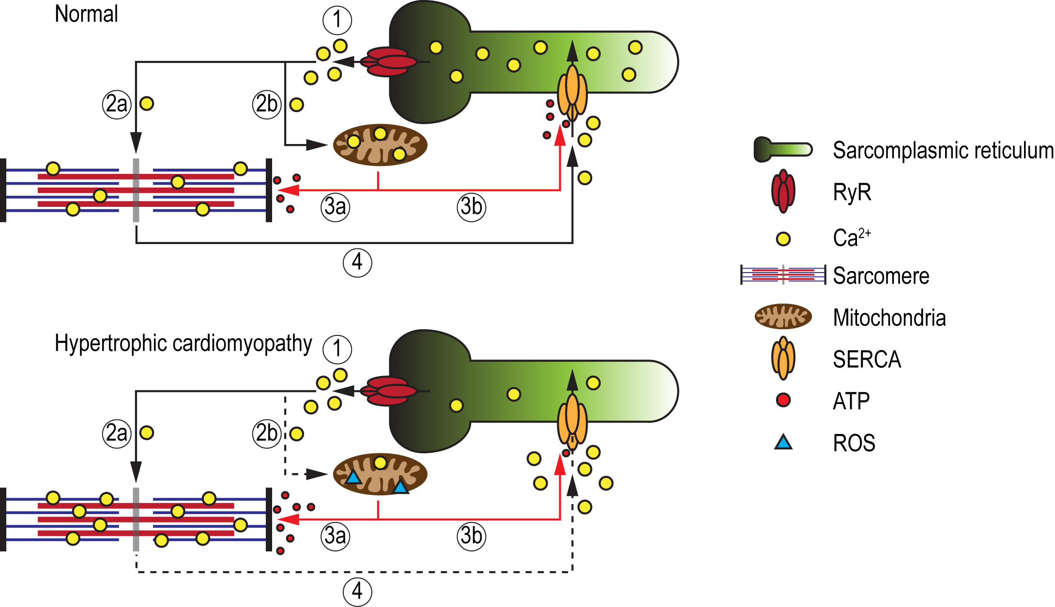
Figure 2. Schematic illustration of the energy deficiency theory in HCM.
Chrishan J.A. Ramachandra., Conditioning Medicine 2019; 2(4):142-151.

