Slide 1
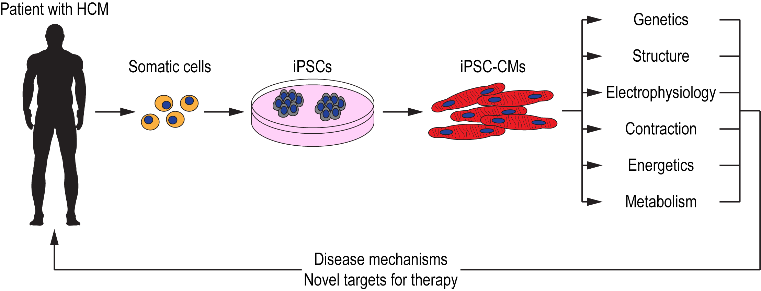
Figure 1. Schematic illustration of iPSC technology for deciphering disease mechanisms and identifying novel therapeutic targets for HCM.
Chrishan J.A. Ramachandra., Conditioning Medicine 2019; 2(4):142-151.

