Slide 1
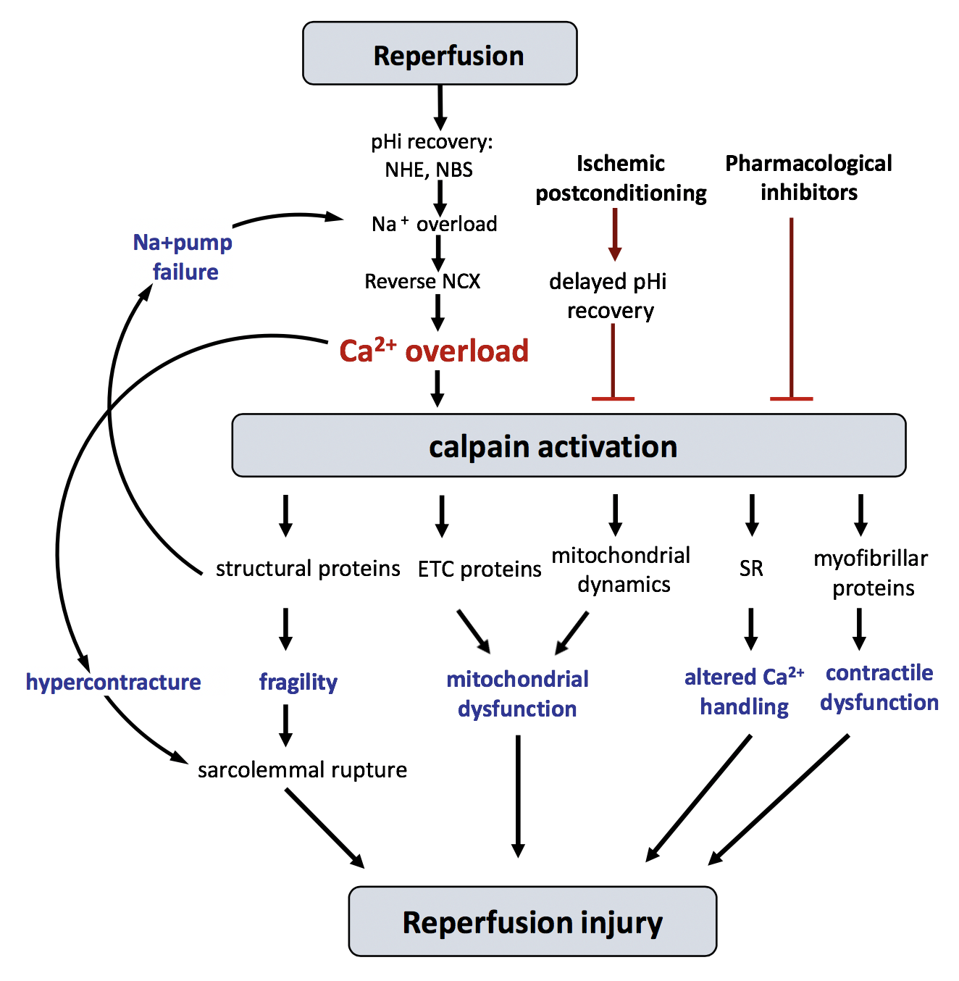
Figure 1. Schematic diagram showing the main proposed mechanisms discussed in the text by which calpains participate in reperfusion injury.
David Aluja et al., Conditioning Medicine 2020. 3(3):160-170.

