Slide 1
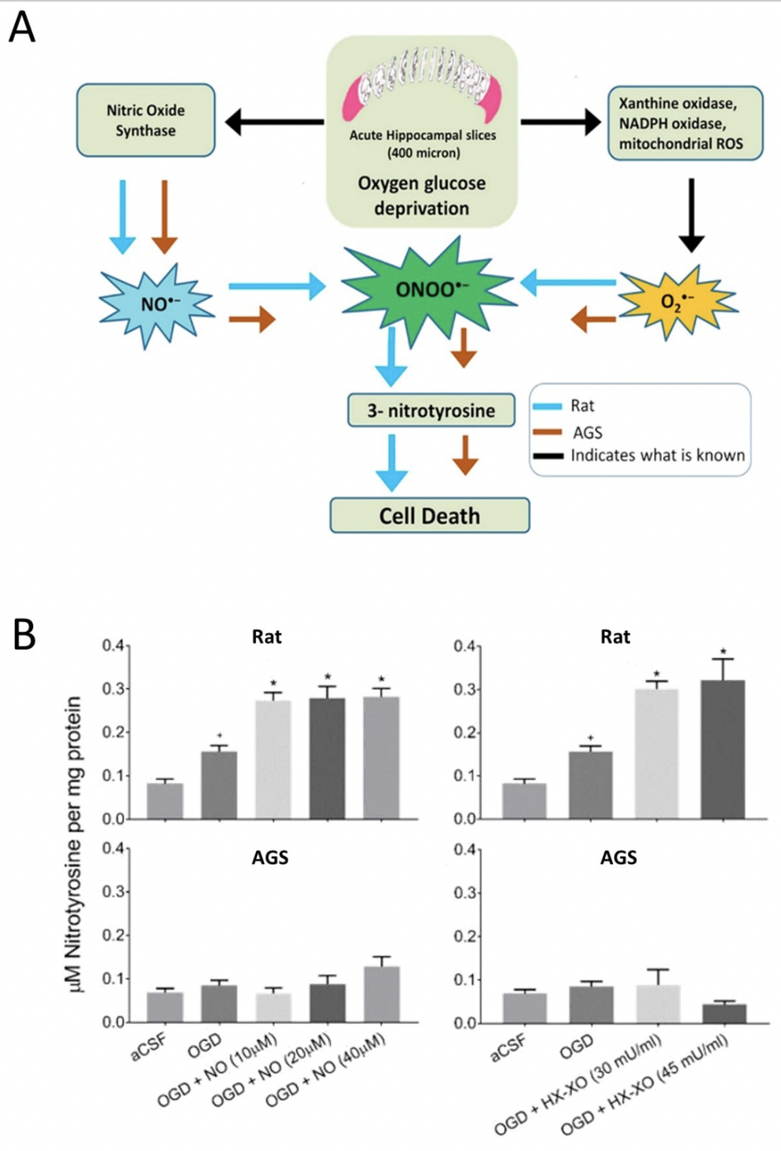
Figure 2. (A) Graphical representation of peroxynitrite mediated oxygen-glucose deprivagtion (OGD) injury in ischemic susceptible rat and ischemic tolerant AGS (B) 3-Nitrotyrosine (3-NT) was measured in rat and AGS slices either subjected to NO donor along with OGD or subjected to O2•- donor along with OGD. *p< 0.05 vs. OGD, +p< 0.05 vs. aCSF. Data shown are means ± SEM. [Reprinted with permission from Bhowmick et al. 2017.]
Saurav Bhowmick et al., Conditioning Medicine 2019; 2(3):134-141.

