Slide 1
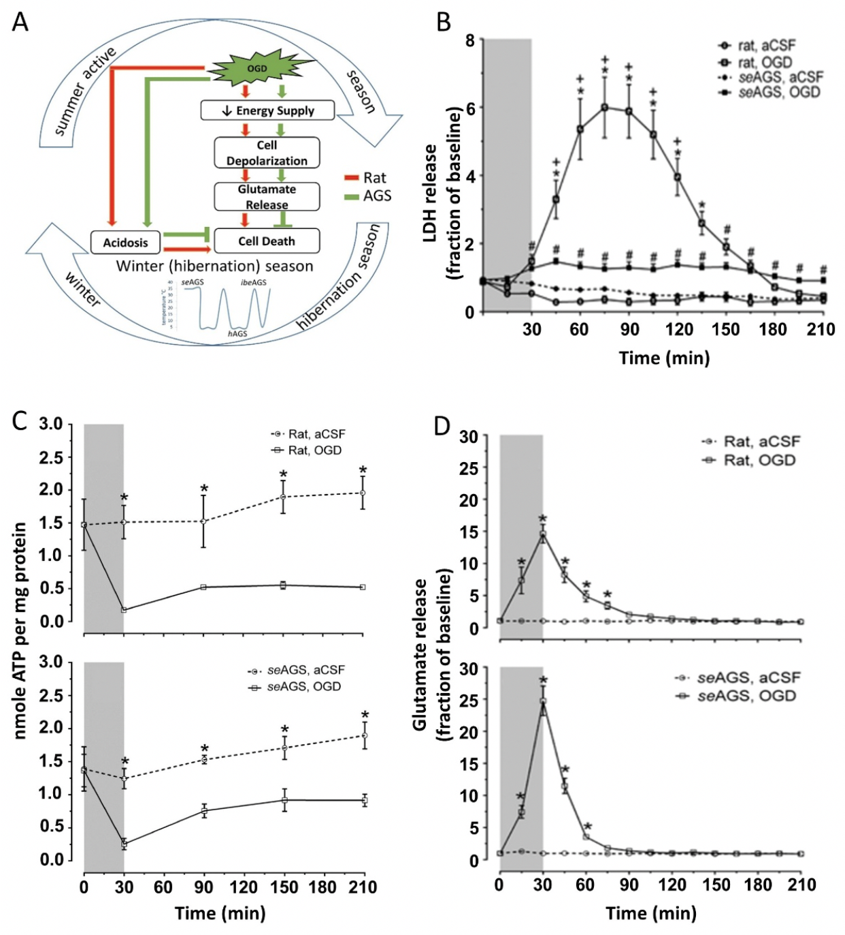
Figure 1. AGS tolerate OGD injury despite ATP loss and glutamate efflux.
Saurav Bhowmick et al., Conditioning Medicine 2019; 2(3):134-141.

