Slide 1
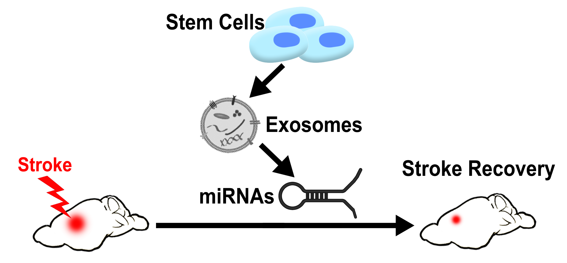
Figure 1.
Borlongan et al., Conditioning Medicine 2023; 6(3): 65-69.

