Slide 1
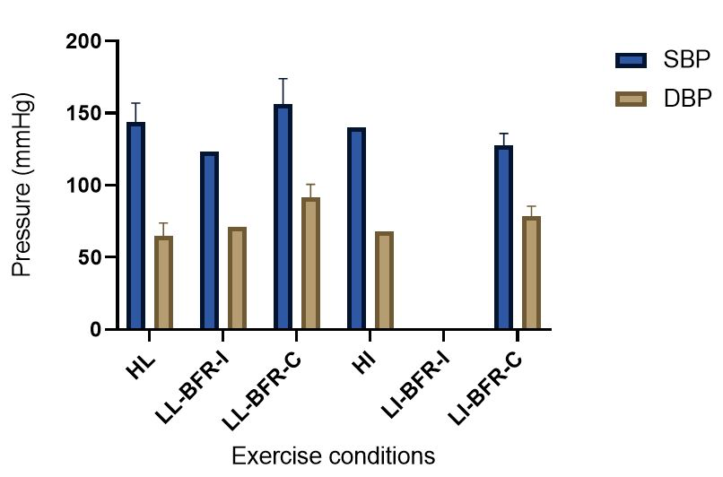
Figure 2.
Schmidt et al., Conditioning Medicine 2022; 5(4): 131-143.

