Slide 1
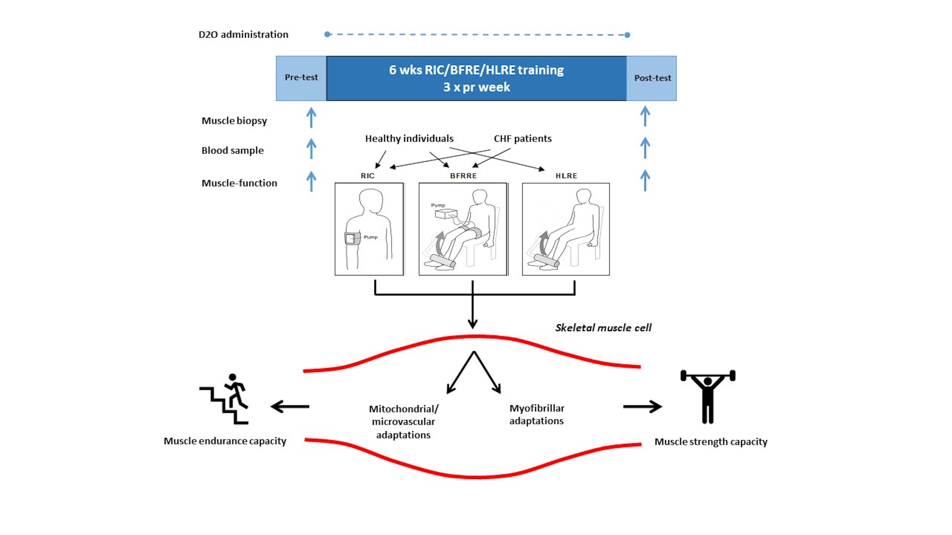
Figure 2. Overview of comparative study on 6 weeks of differentiated conditioning intervention.
Vissing et al., Conditioning Medicine 2021; 4(3):141-150.

