Slide 1
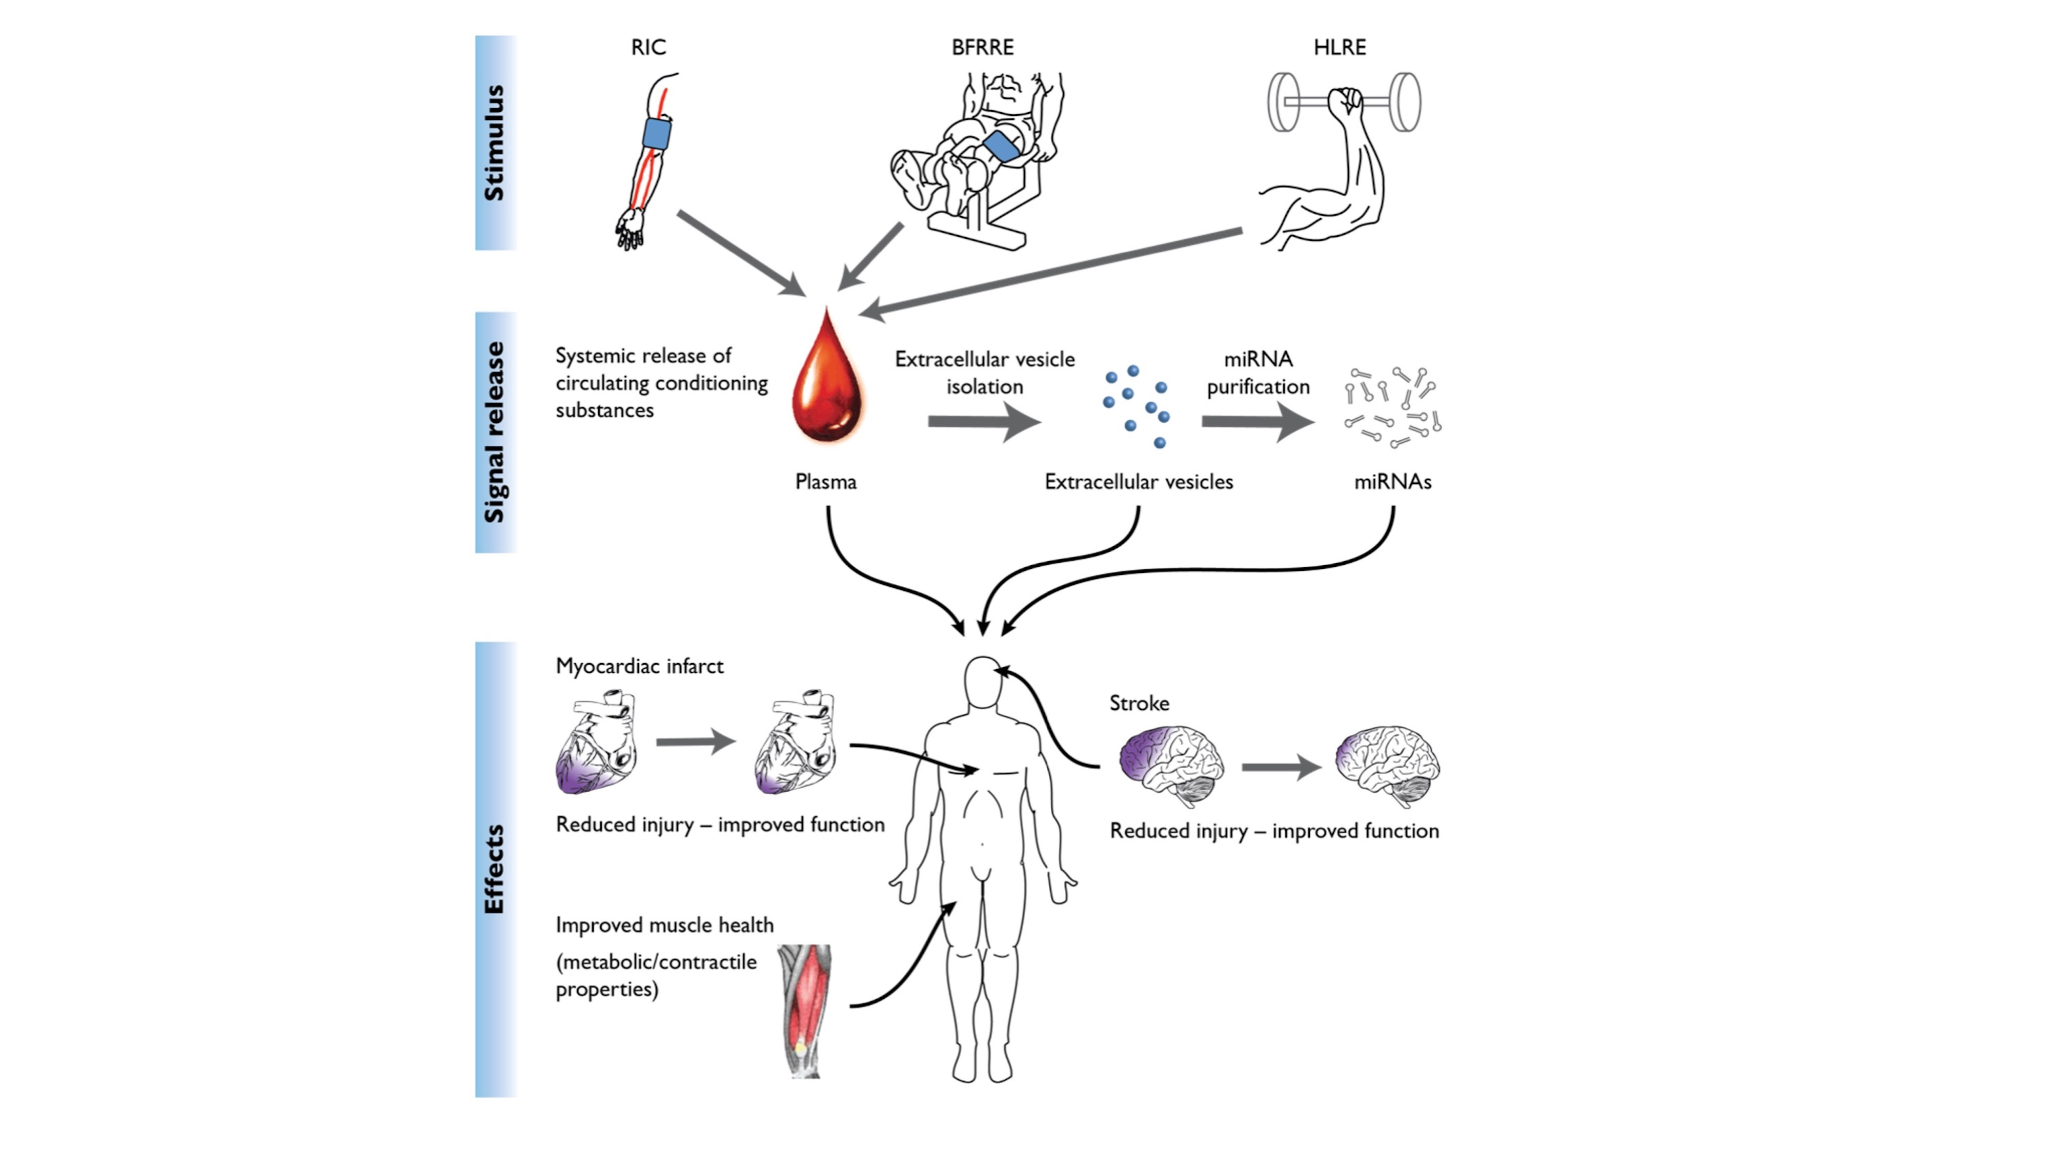
Figure 1. Event scheme of ischemia ± exercise preconditioning.
Vissing et al., Conditioning Medicine 2021; 4(3):141-150.

