Slide 1
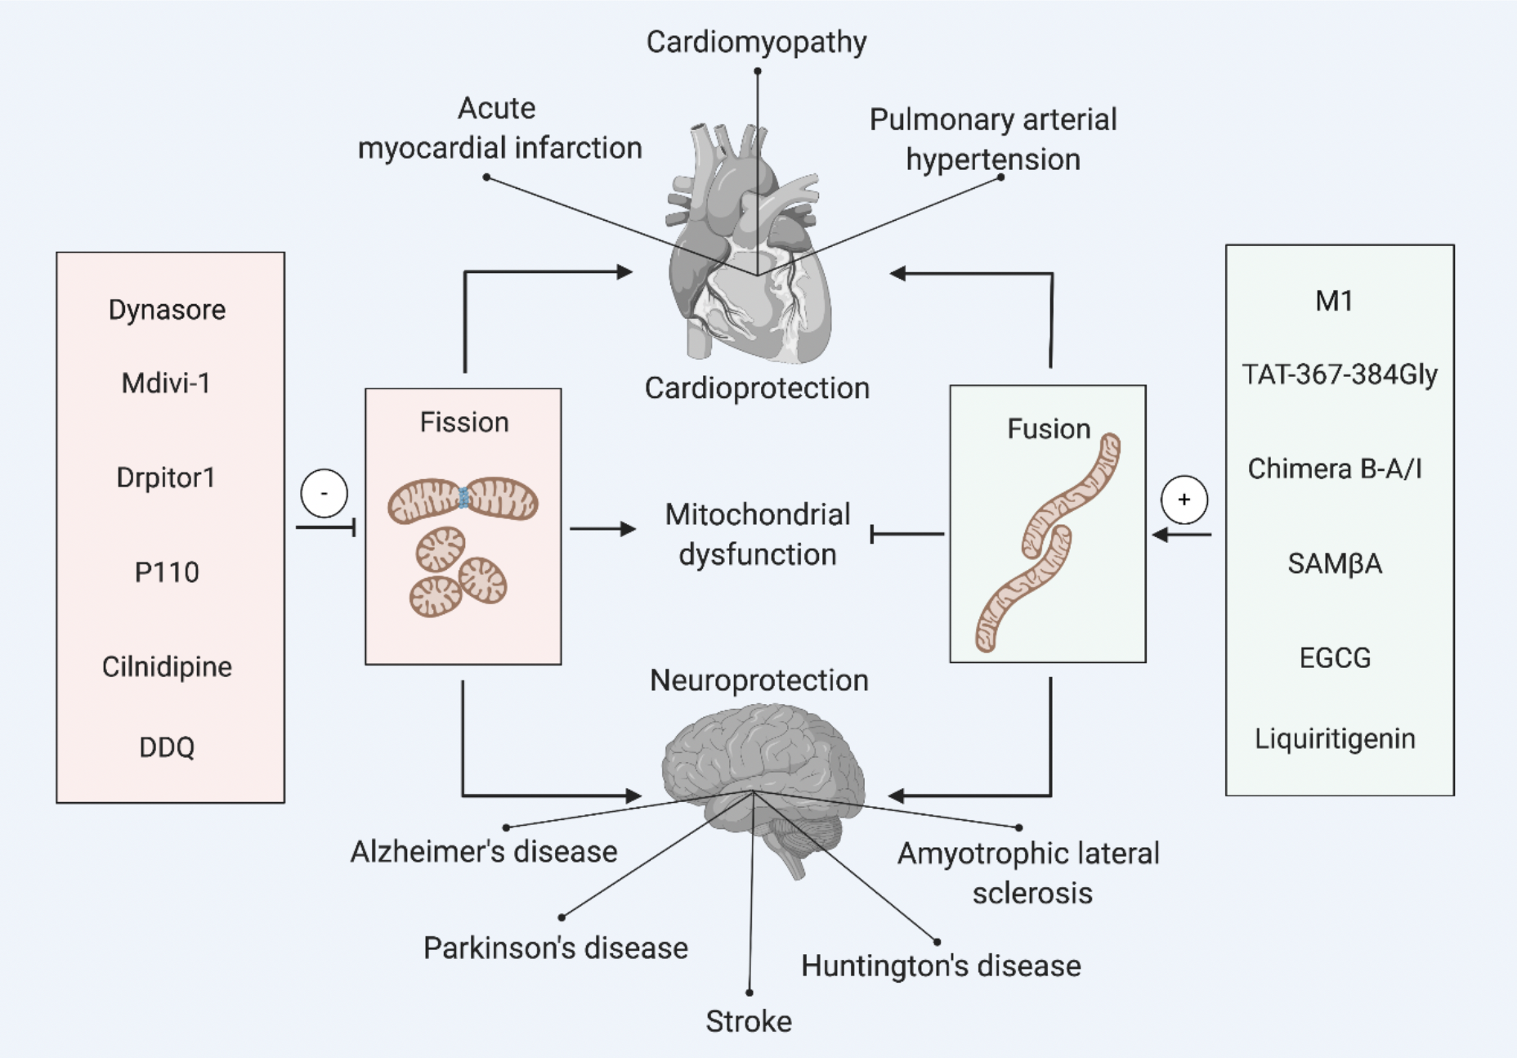
Figure 1. Pharmacological modulators of mitochondrial dynamics for cardioprotection and neuroprotection.
Siavash Beikoghli Kalkhoran et al., Conditioning Medicine 2020. 3(3):144-159.

