Slide 1
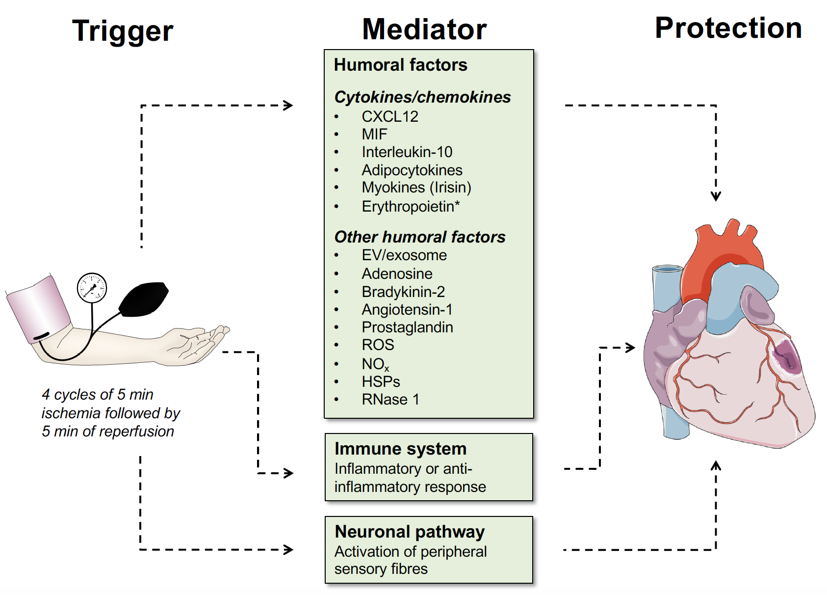
Figure 1. Overview of mediators that can serve as a RIPC trigger in cardioprotection.
Christian Stoppe et al., Conditioning Medicine 2019; 2(3):122-133.

