Slide 1
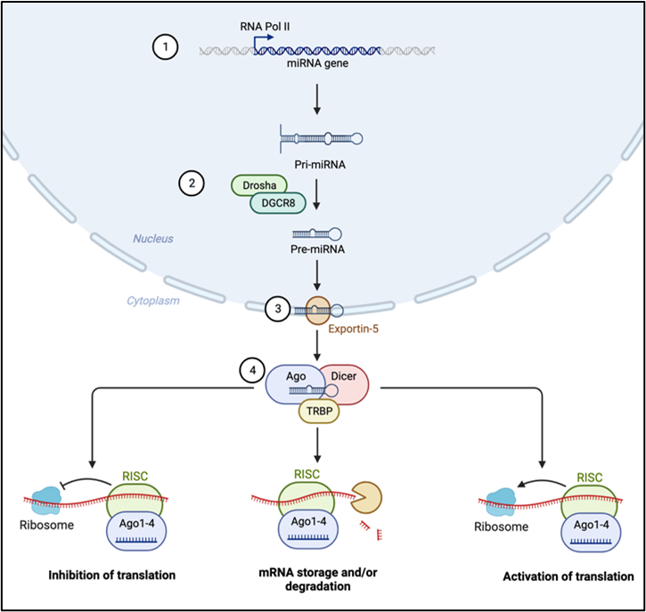
Figure 1.
Prakash and Hernandez-Resendiz, Conditioning Medicine 2023; 6(3): 70-77.

