Slide 1
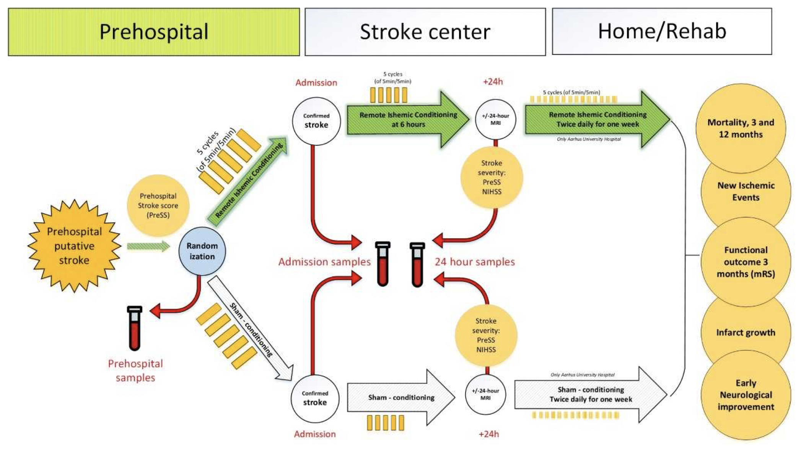
Figure 2. RESIST Trial Biomarker substudy Blood samples are drawn at the 3 time points shown by the red arrows: 1.) in the ambulance immediately after randomization to RIC or sham RIC; 2.) after arrival at the stroke center and 3.) at 24 hrs after randomization.
Hess et al., Conditioning Medicine 2021; 4(3):124-129.

