Slide 1
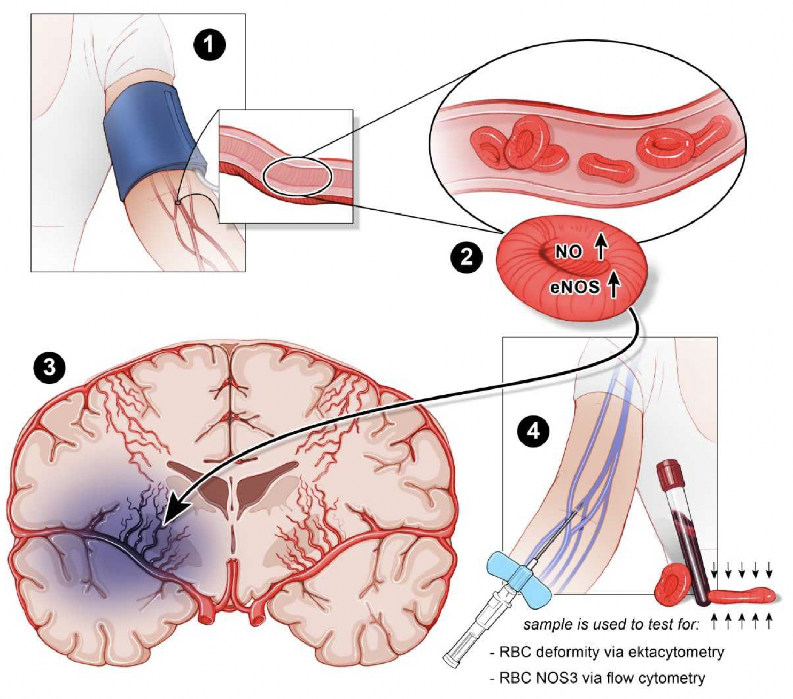
Figure 1. 1) RIC (arm) in the ambulance. 2) Shear stress increases RBC or eryNOS3 and improves deformability. 3) Increase in eryNOS3 “rescues” endothelial NOS3 and improved RBC deformability improves collateral flow. 4) Biomarker analysis in blood samples drawn pre and post RIC.
Hess et al., Conditioning Medicine 2021; 4(3):124-129.

