Slide 1
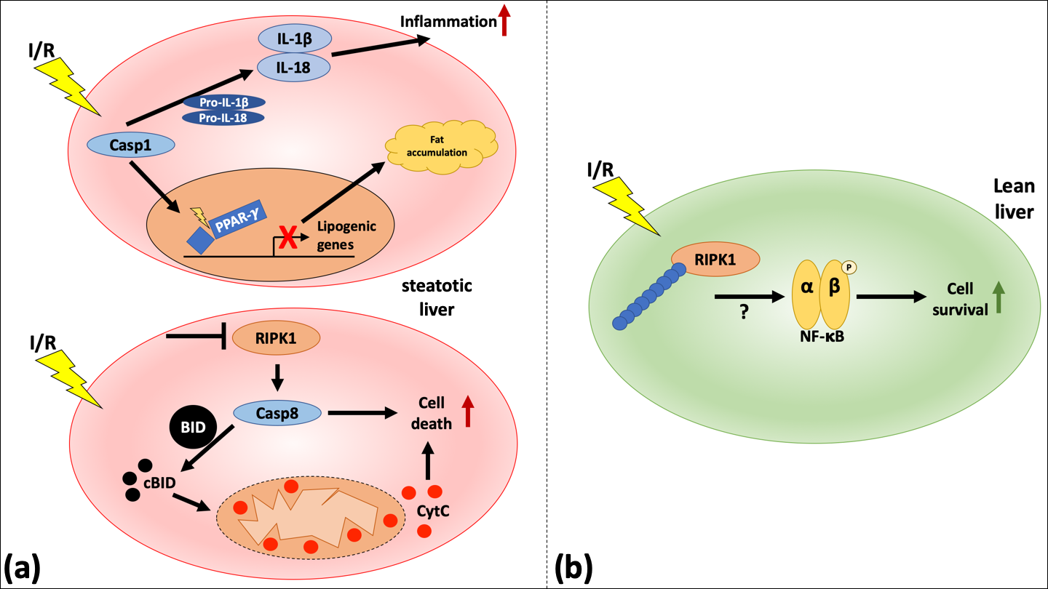
Figure 1. Schematic representation of RIPK1-mediated signaling in steatotic compared to lean livers undergoing IRI.
Christoph Emontzpohl et al., Conditioning Medicine 2020; 3(3):135-143.

