Slide 1
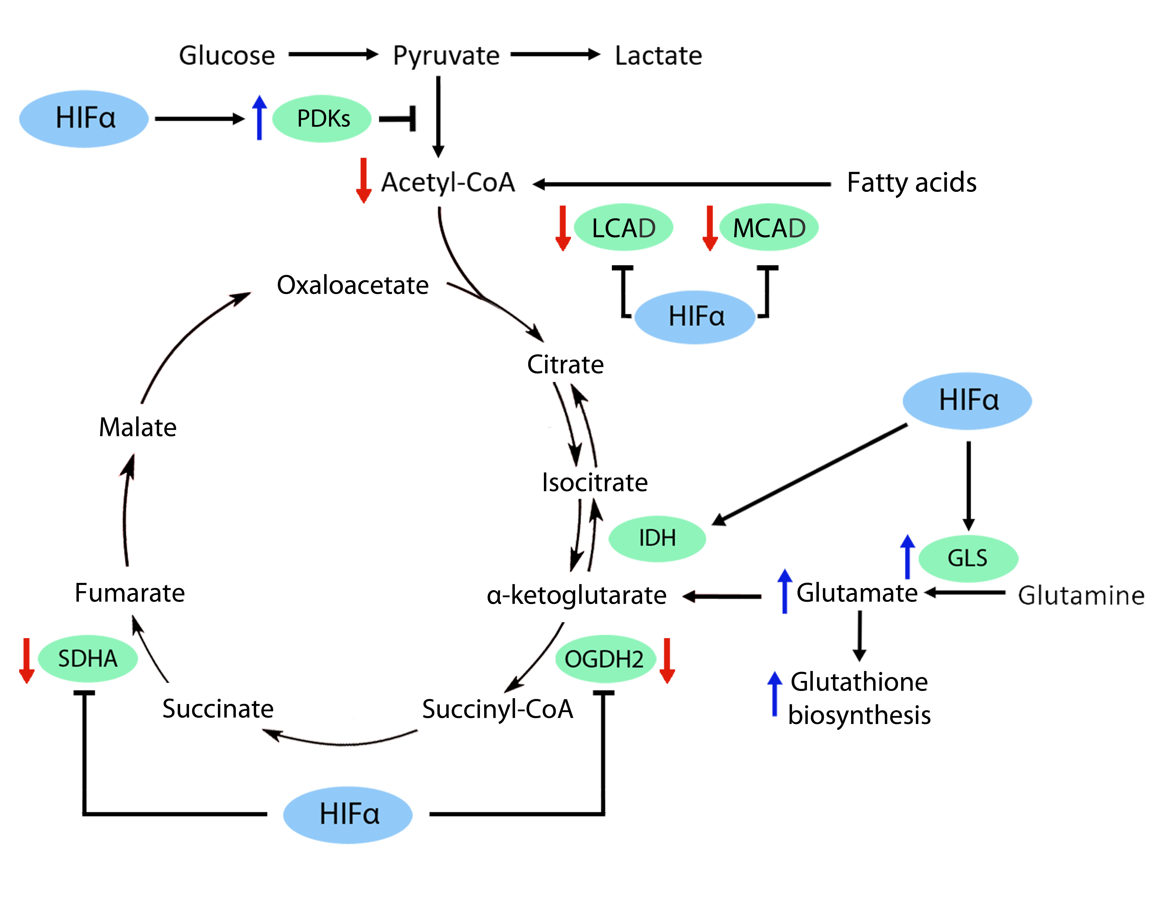
Figure 3. HIF-dependent pathways that reprogram the TCA cycle.
Claudia Mesa-Ciller et al., Conditioning Medicine 2019; 2(3):114-121.

