Slide 1
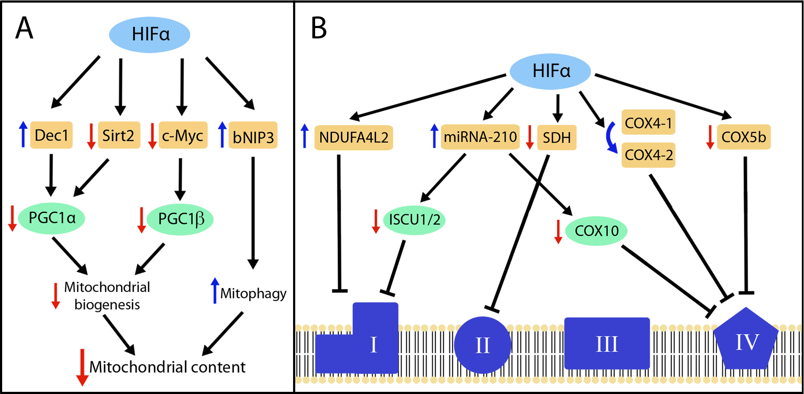
Figure 2. HIF-dependent pathways involved in the suppression of mitochondrial content and mitochondrial respiratory chain activity.
Claudia Mesa-Ciller et al., Conditioning Medicine 2019; 2(3):114-121.

