Slide 1
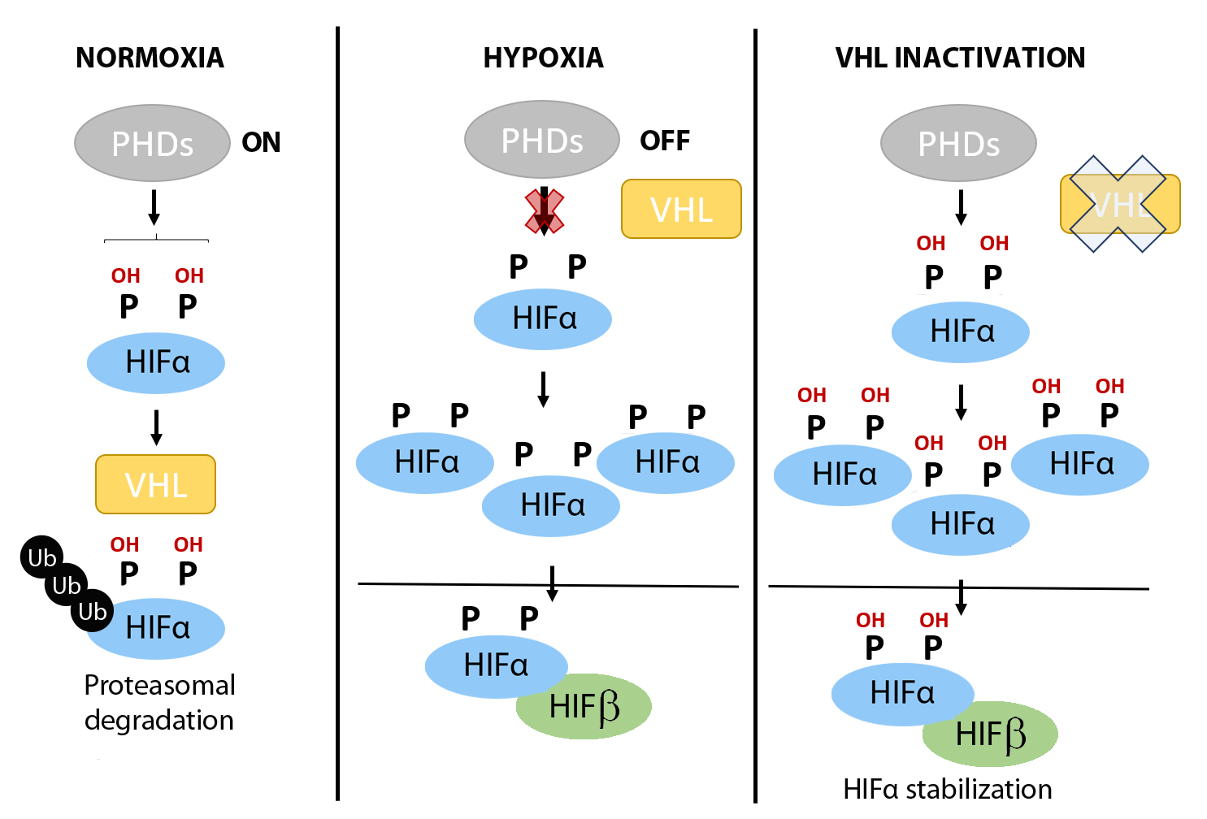
Figure 1. Regulation of HIFα subunits stabilization by oxygen fluctuations and in VHL deficient tumor cells.
Claudia Mesa-Ciller et al., Conditioning Medicine 2019; 2(3):114-121.

