Slide 1
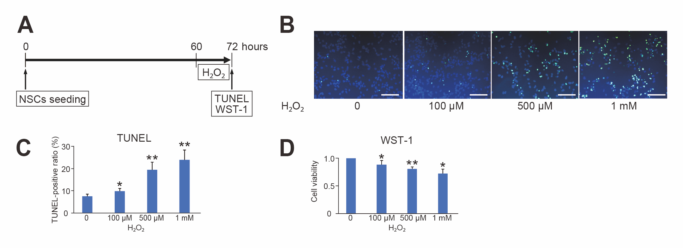
Figure 2.
Fukuda et al., Conditioning Medicine 2023; 6(4): 138-146.

