Slide 1
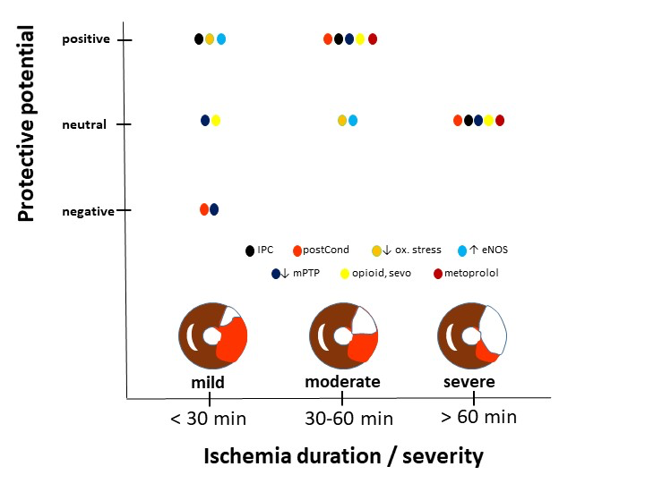
Figure 1.
Xiao et al., Conditioning Medicine 2022; 5(3): 93-99.

