Slide 1
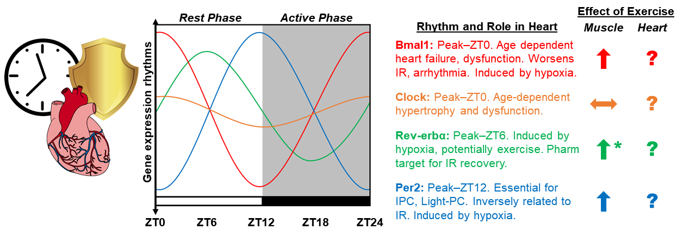
Figure 1. Diagram depicting the proposed integration of chronobiology and exercise-induced cardioprotection.
Graham R. McGinnis and John C. Quindry, Conditioning Medicine 2020; 3(2):71-81.

