Slide 1
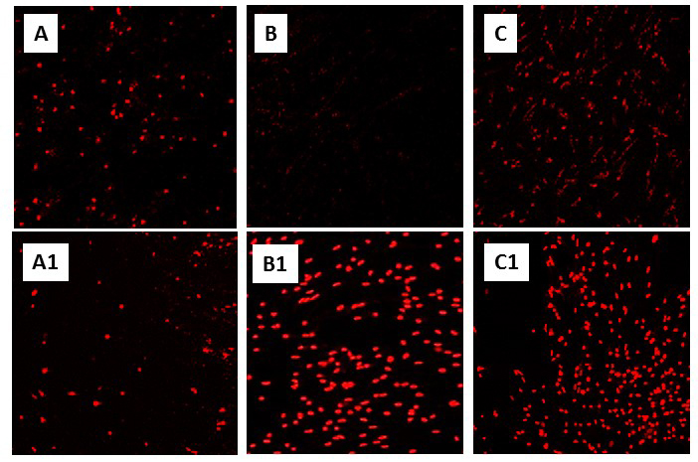
Figure 2. Knockdown of Hsp72 significantly increases cell death in primary neuronal cultures of T. scripta (see “Constitutive adaptations that promote anoxic survival” in text, and Kesaraju et al., 2014).
Milton et al., Conditioning Medicine 2019; 2(2):90-105.

