Slide 1
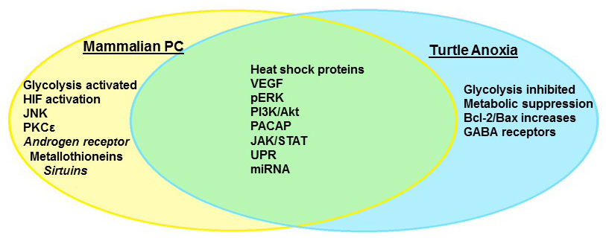
Figure 1. Anoxia tolerance in the freshwater turtle and mammalian preconditioning share many molecular pathways that comprise the “survival phenotype.” Some mechanisms are unique to facultative anaerobes such as the turtle, which repress overall metabolism to survive extended anoxia.
Milton et al., Conditioning Medicine 2019; 2(2):90-105.

