Slide 1
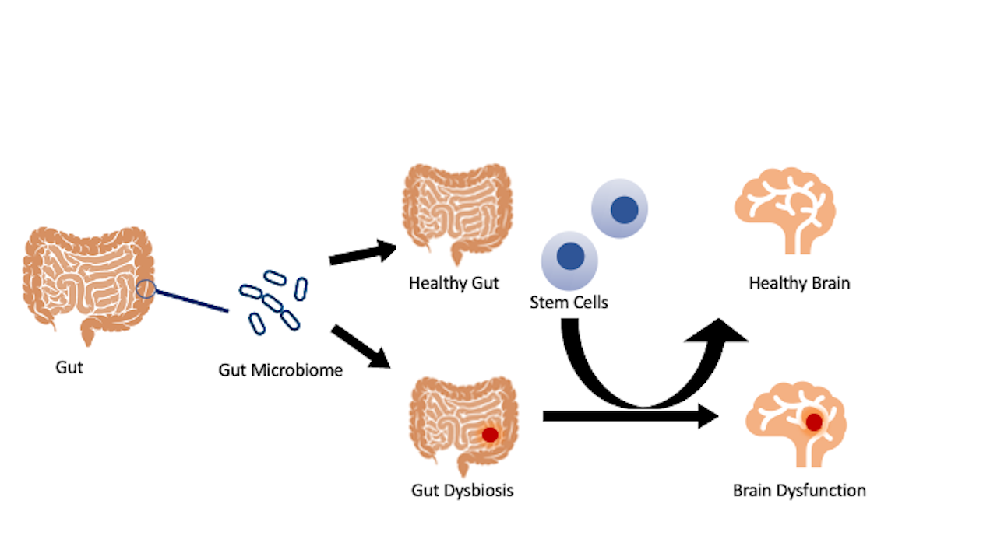
Figure 1. Stroke gut and brain pathology.
Moscatello et al., Conditioning Medicine 2021; 4(2):119-123.

