Slide 1
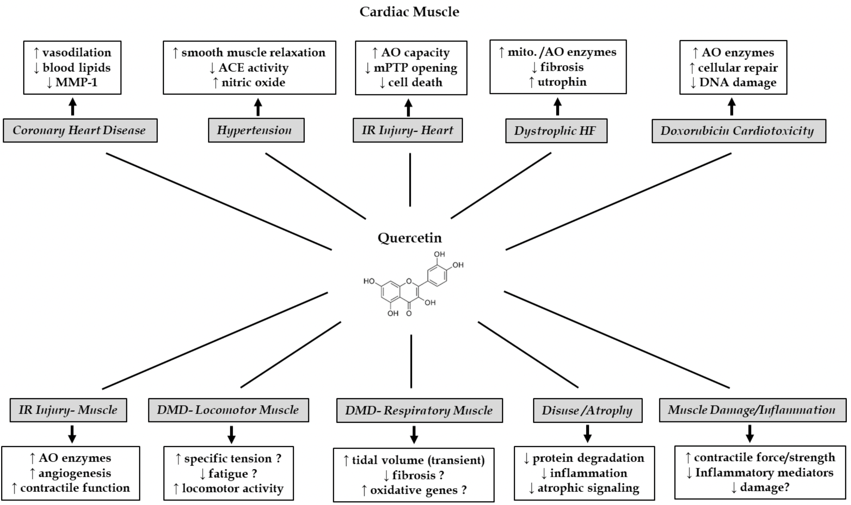
Figure 3. Quercetin effects on skeletal and cardiac muscle in CVD and NMD. Summary of possible benefits and mechanisms by which quercetin may confer protection against various chronic diseases. Uncertain outcomes are followed by “?”.
Christopher G. Ballmann et al., Conditioning Medicine 2020; 3(3):117-124.

