Slide 1
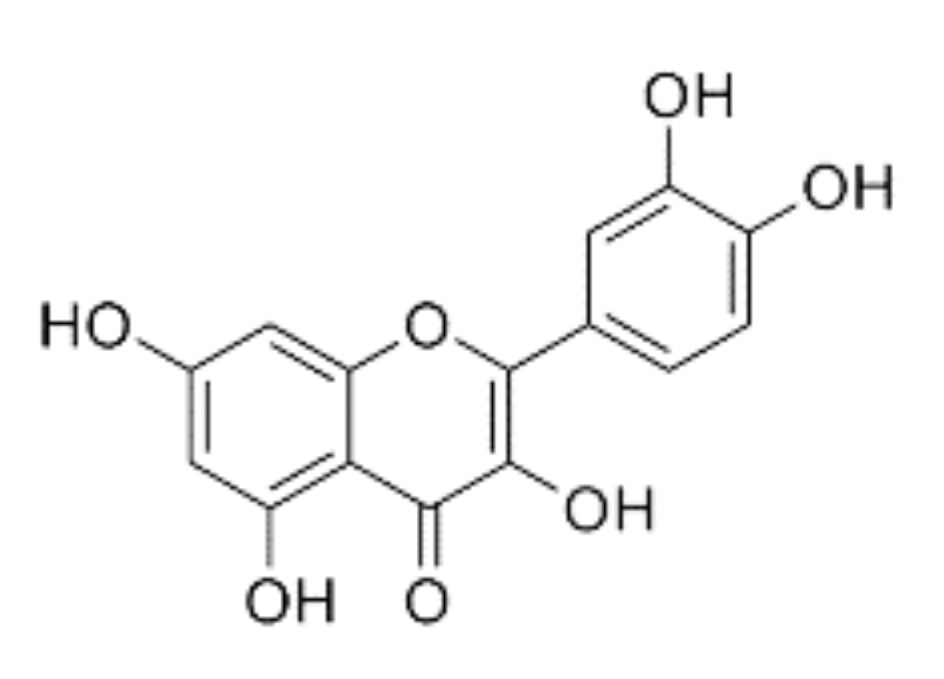
Figure 1. Chemical structure of quercetin. IUPAC 2- (3,4-dihydroxyphenyl)-3,5,7 trihydroxychromen-4-one. Molecular weight: 302.23 g/mol.
Christopher G. Ballmann et al., Conditioning Medicine 2020; 3(3):117-124.

