Slide 1
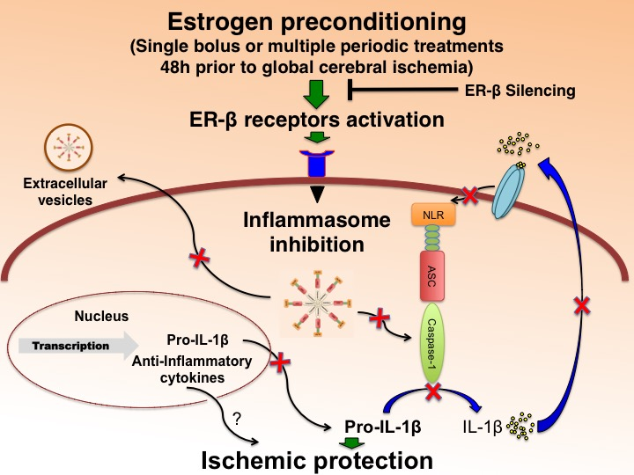
Figure 2: E2/ER-β agonist preconditioning regulates inflammasome activation and protects the brain from global ischemic damage in female rats.
Juan Pablo de Rivero Vaccari et al., Conditioning Medicine 2019; 2(3):106-133.

