Slide 1
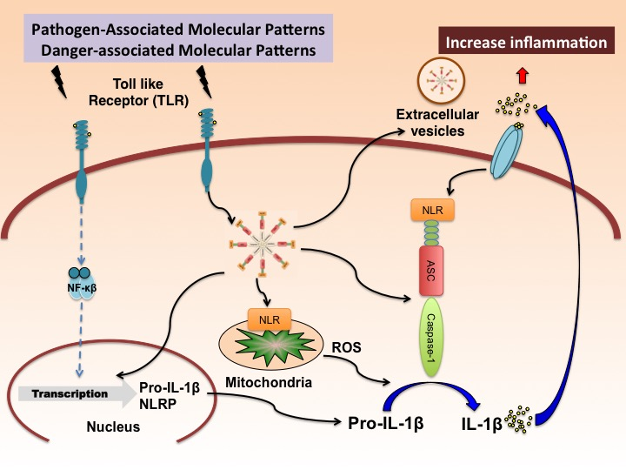
Figure 1. Putative mechanism of inflammasome activation in the brain.
Juan Pablo de Rivero Vaccari et al., Conditioning Medicine 2019; 2(3):106-133.

