Slide 1
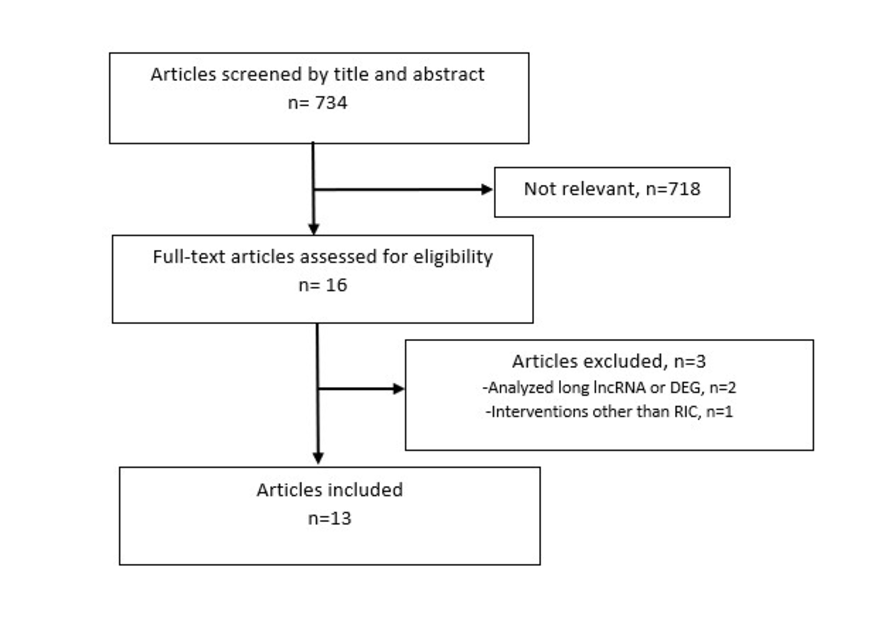
Figure 2.
Lunding et al., Conditioning Medicine 2022; 5(4): 112-122.

