Slide 1
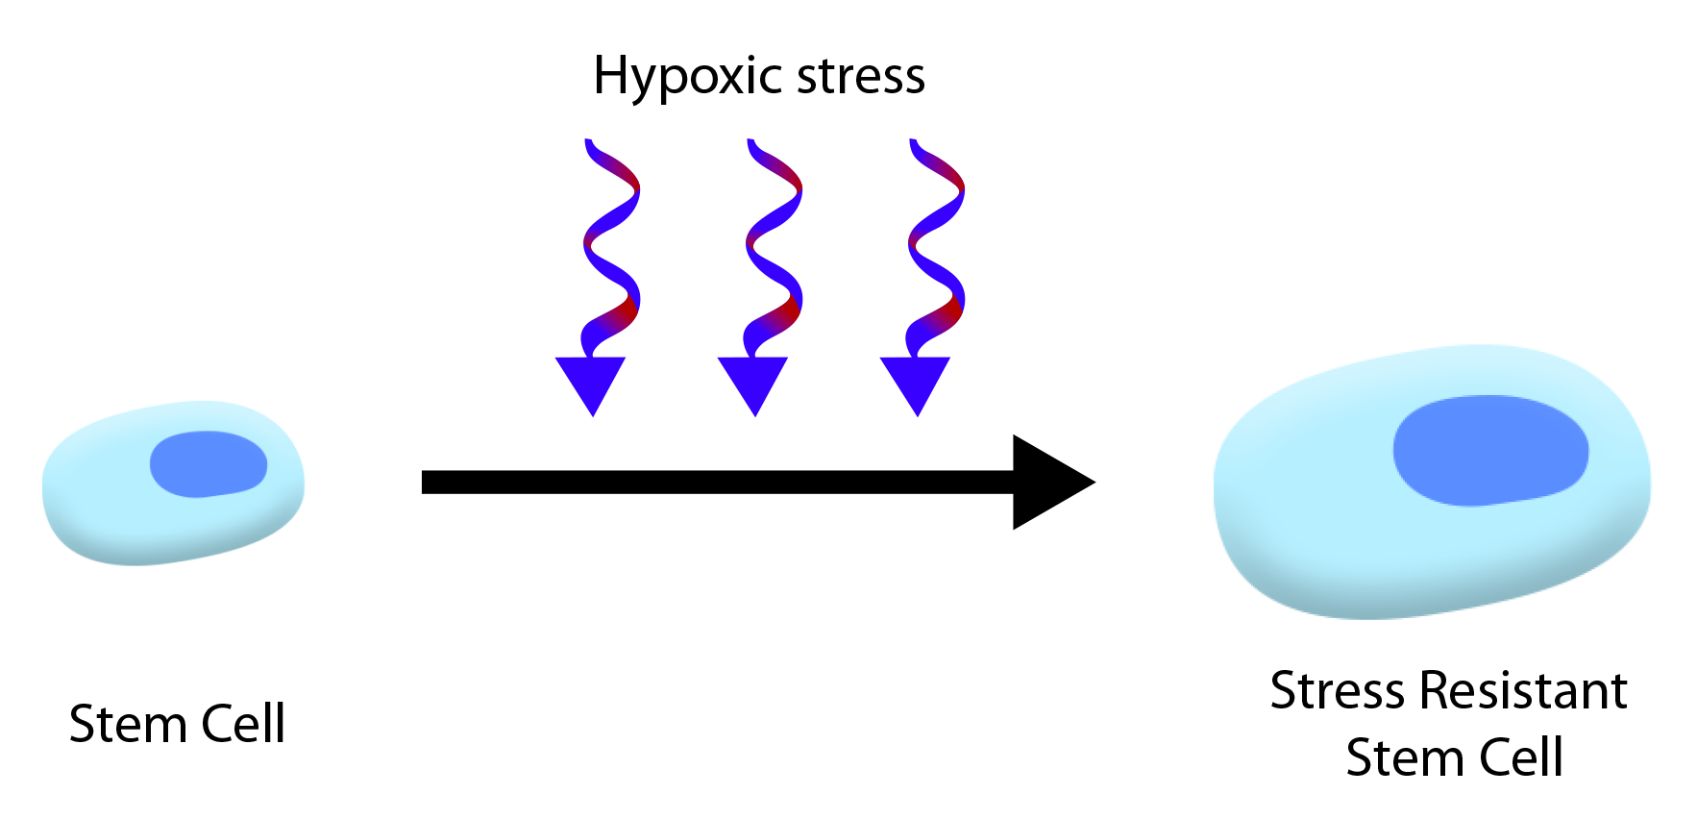
Figure 1. Conditioning of stem cells.
Kingsbury et al., Conditioning Medicine 2021; 4(2):100-112.

