Slide 1
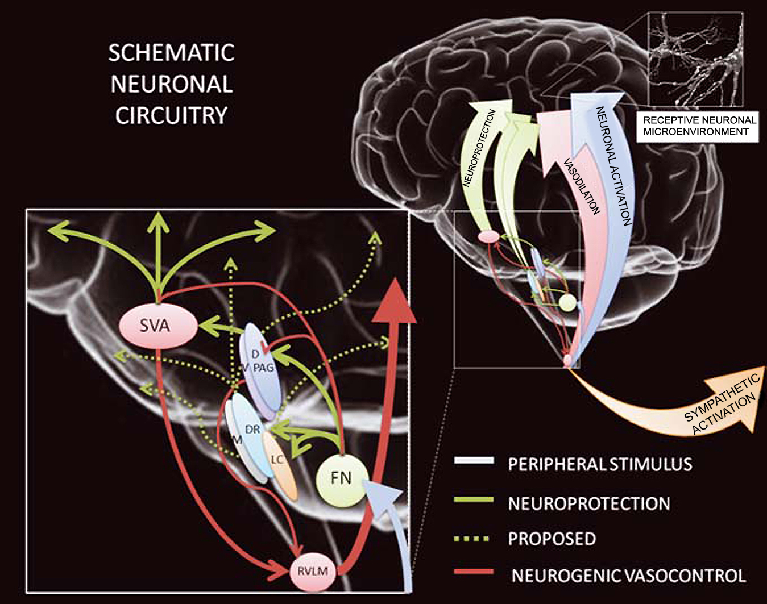
Figure 2. The neuroprotection circuitry might encompass neuronal circuitry involved in the coupling between neuronal activation and its consequent energetic demands.
Golanov et al., Conditioning Medicine 2019; 2(2):75-89.

