Slide 1
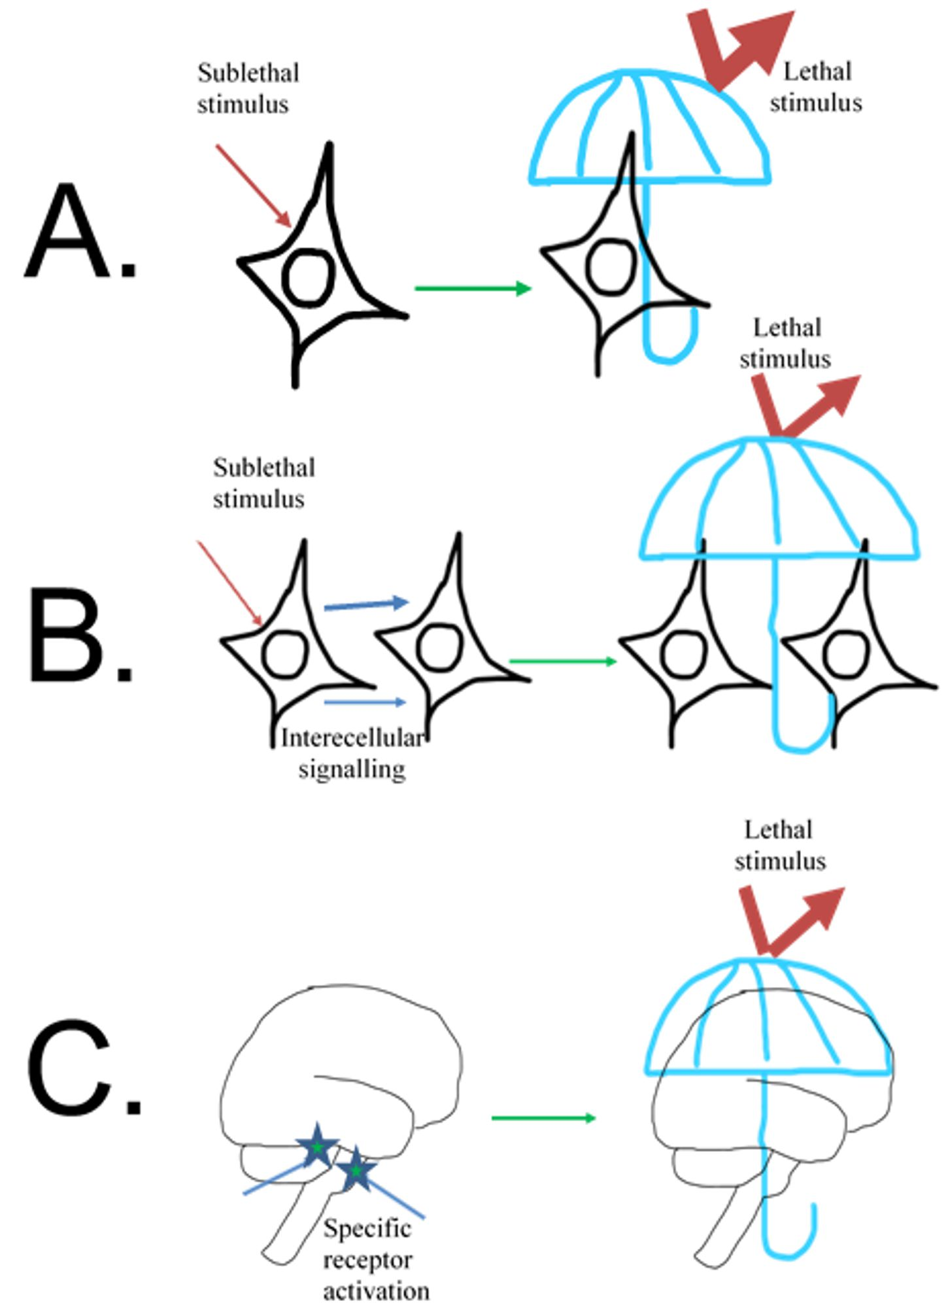
Figure 1. Different levels of innate self-defense.
Golanov et al., Conditioning Medicine 2019; 2(2):75-89.

