Slide 1
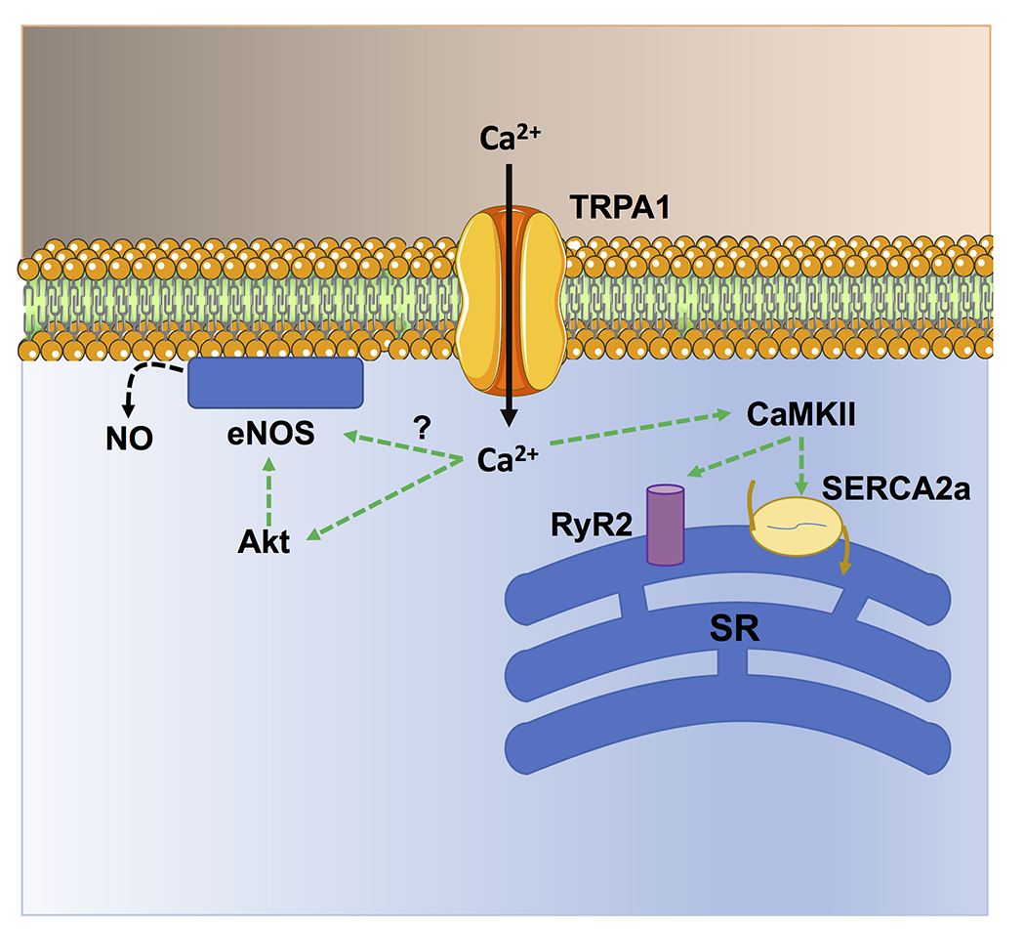
Figure 3.
Francesco Moccia and Michele Samaja, Conditioning Medicine 2023; 6(6): 197-207.

