Slide 1
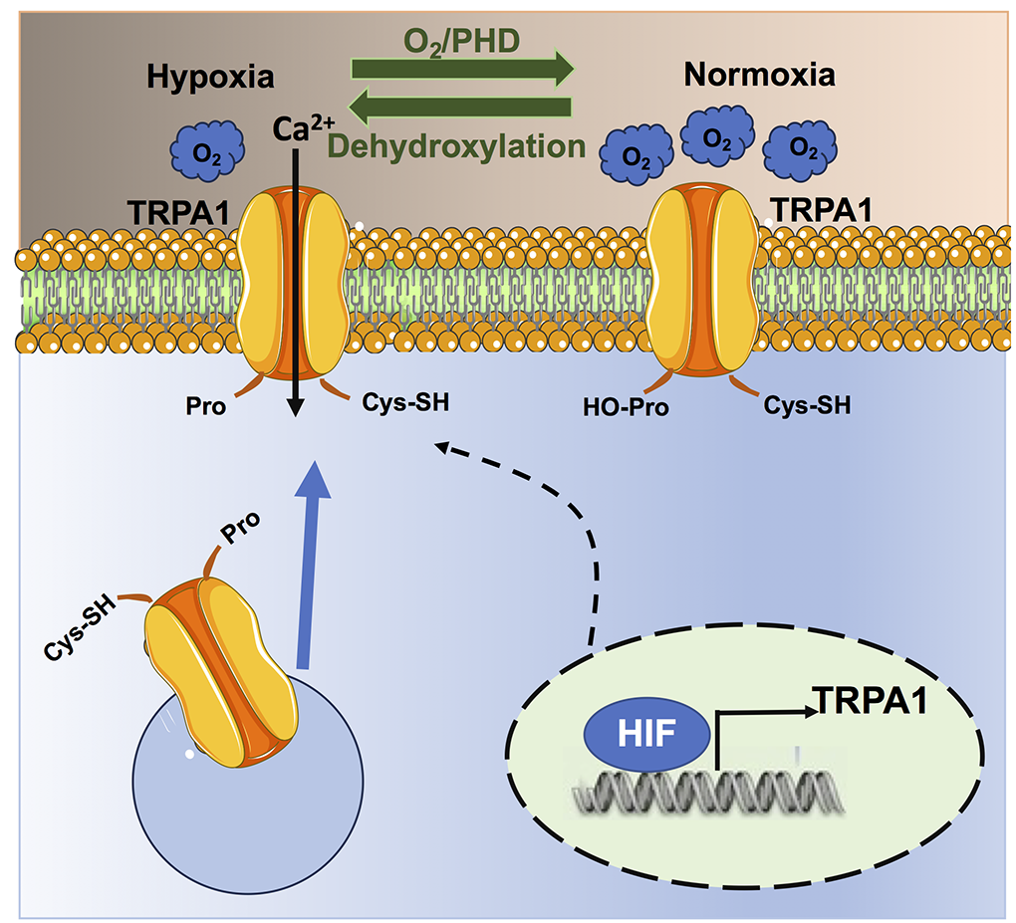
Figure 1.
Francesco Moccia and Michele Samaja, Conditioning Medicine 2023; 6(6): 197-207.

