Slide 1
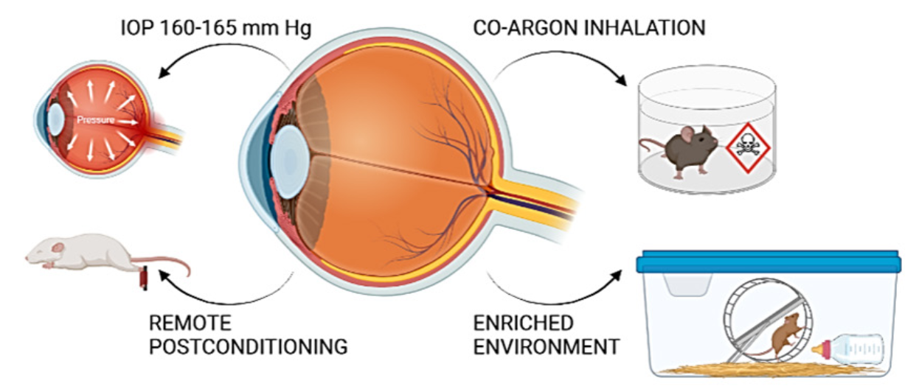
Figure 2.
Franco et al., Conditioning Medicine 2023; 6(3): 78-87.

