Slide 1
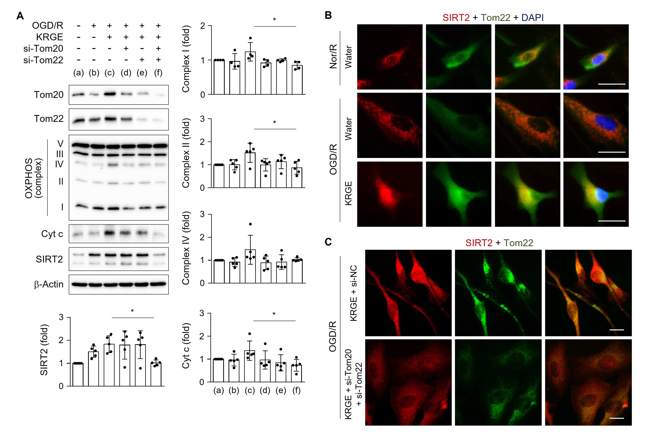
Figure 3.
Jeon et al., Conditioning Medicine 2022; 5(3):105-111.

