Slide 1
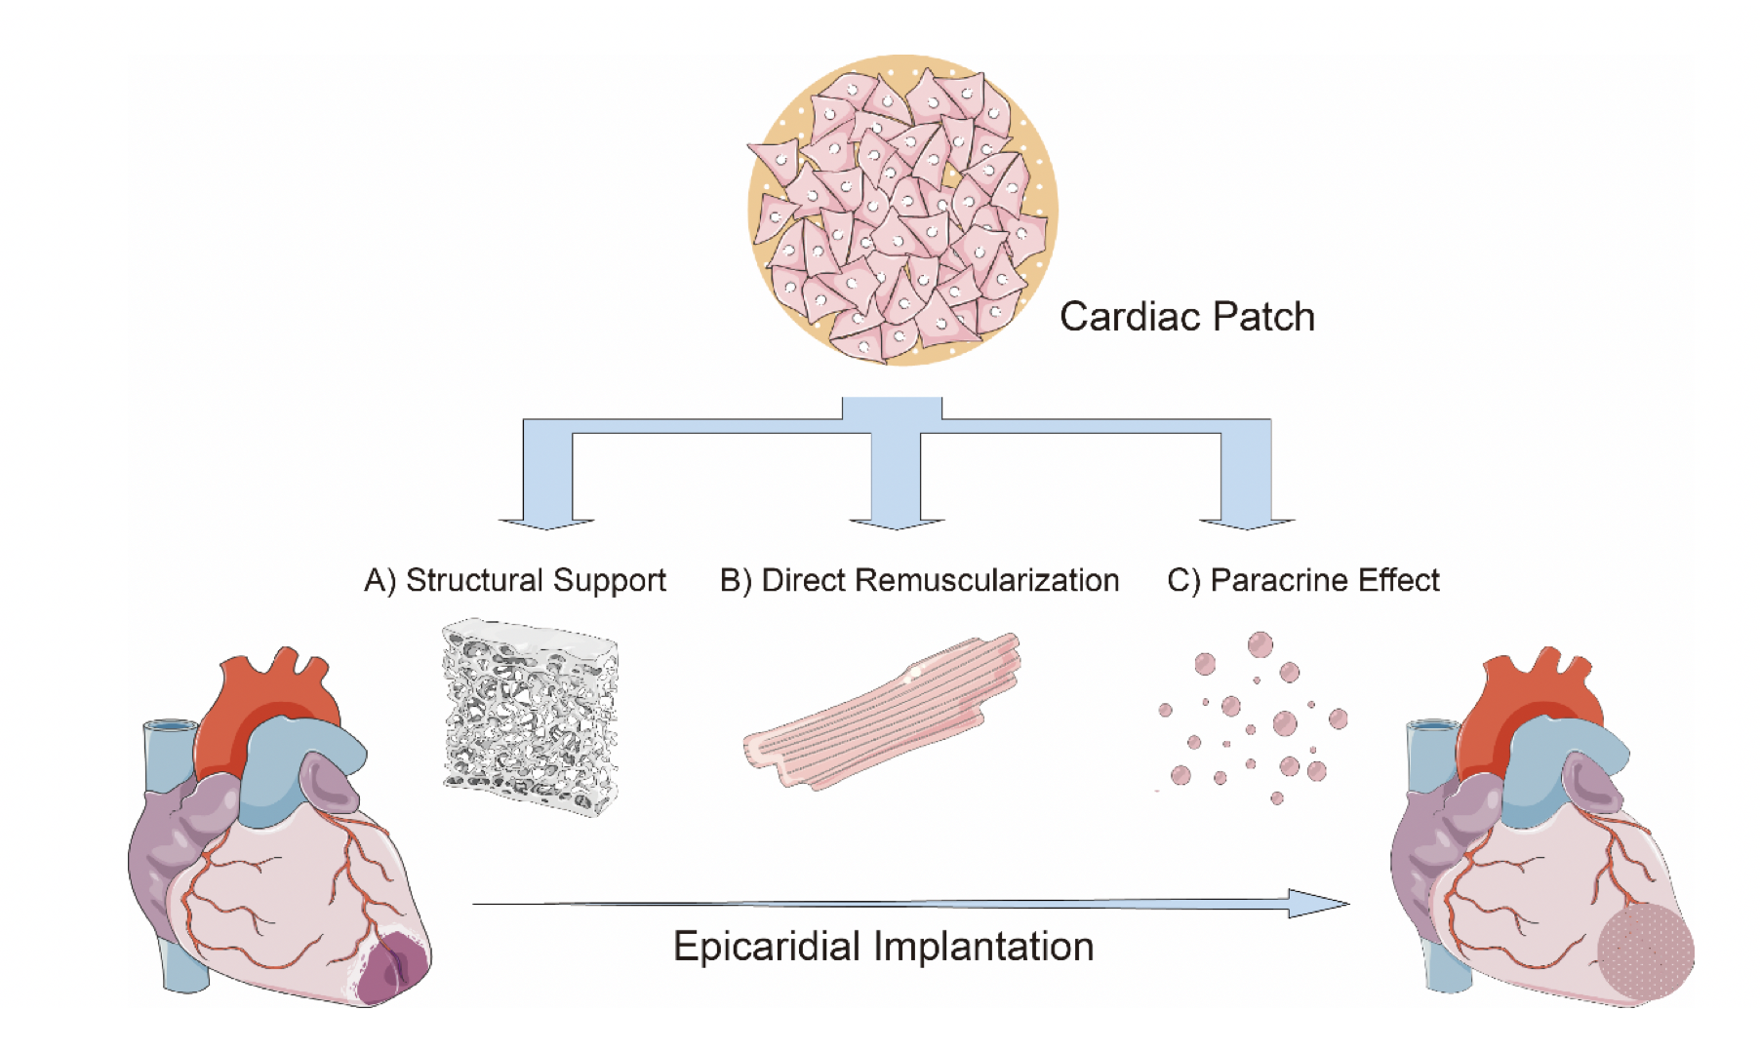
Figure 1. Schematic description of the mechanistic action of cardiac patch.
Cong et al., Conditioning Medicine 2021; 4(2):100-112.

