Slide 1
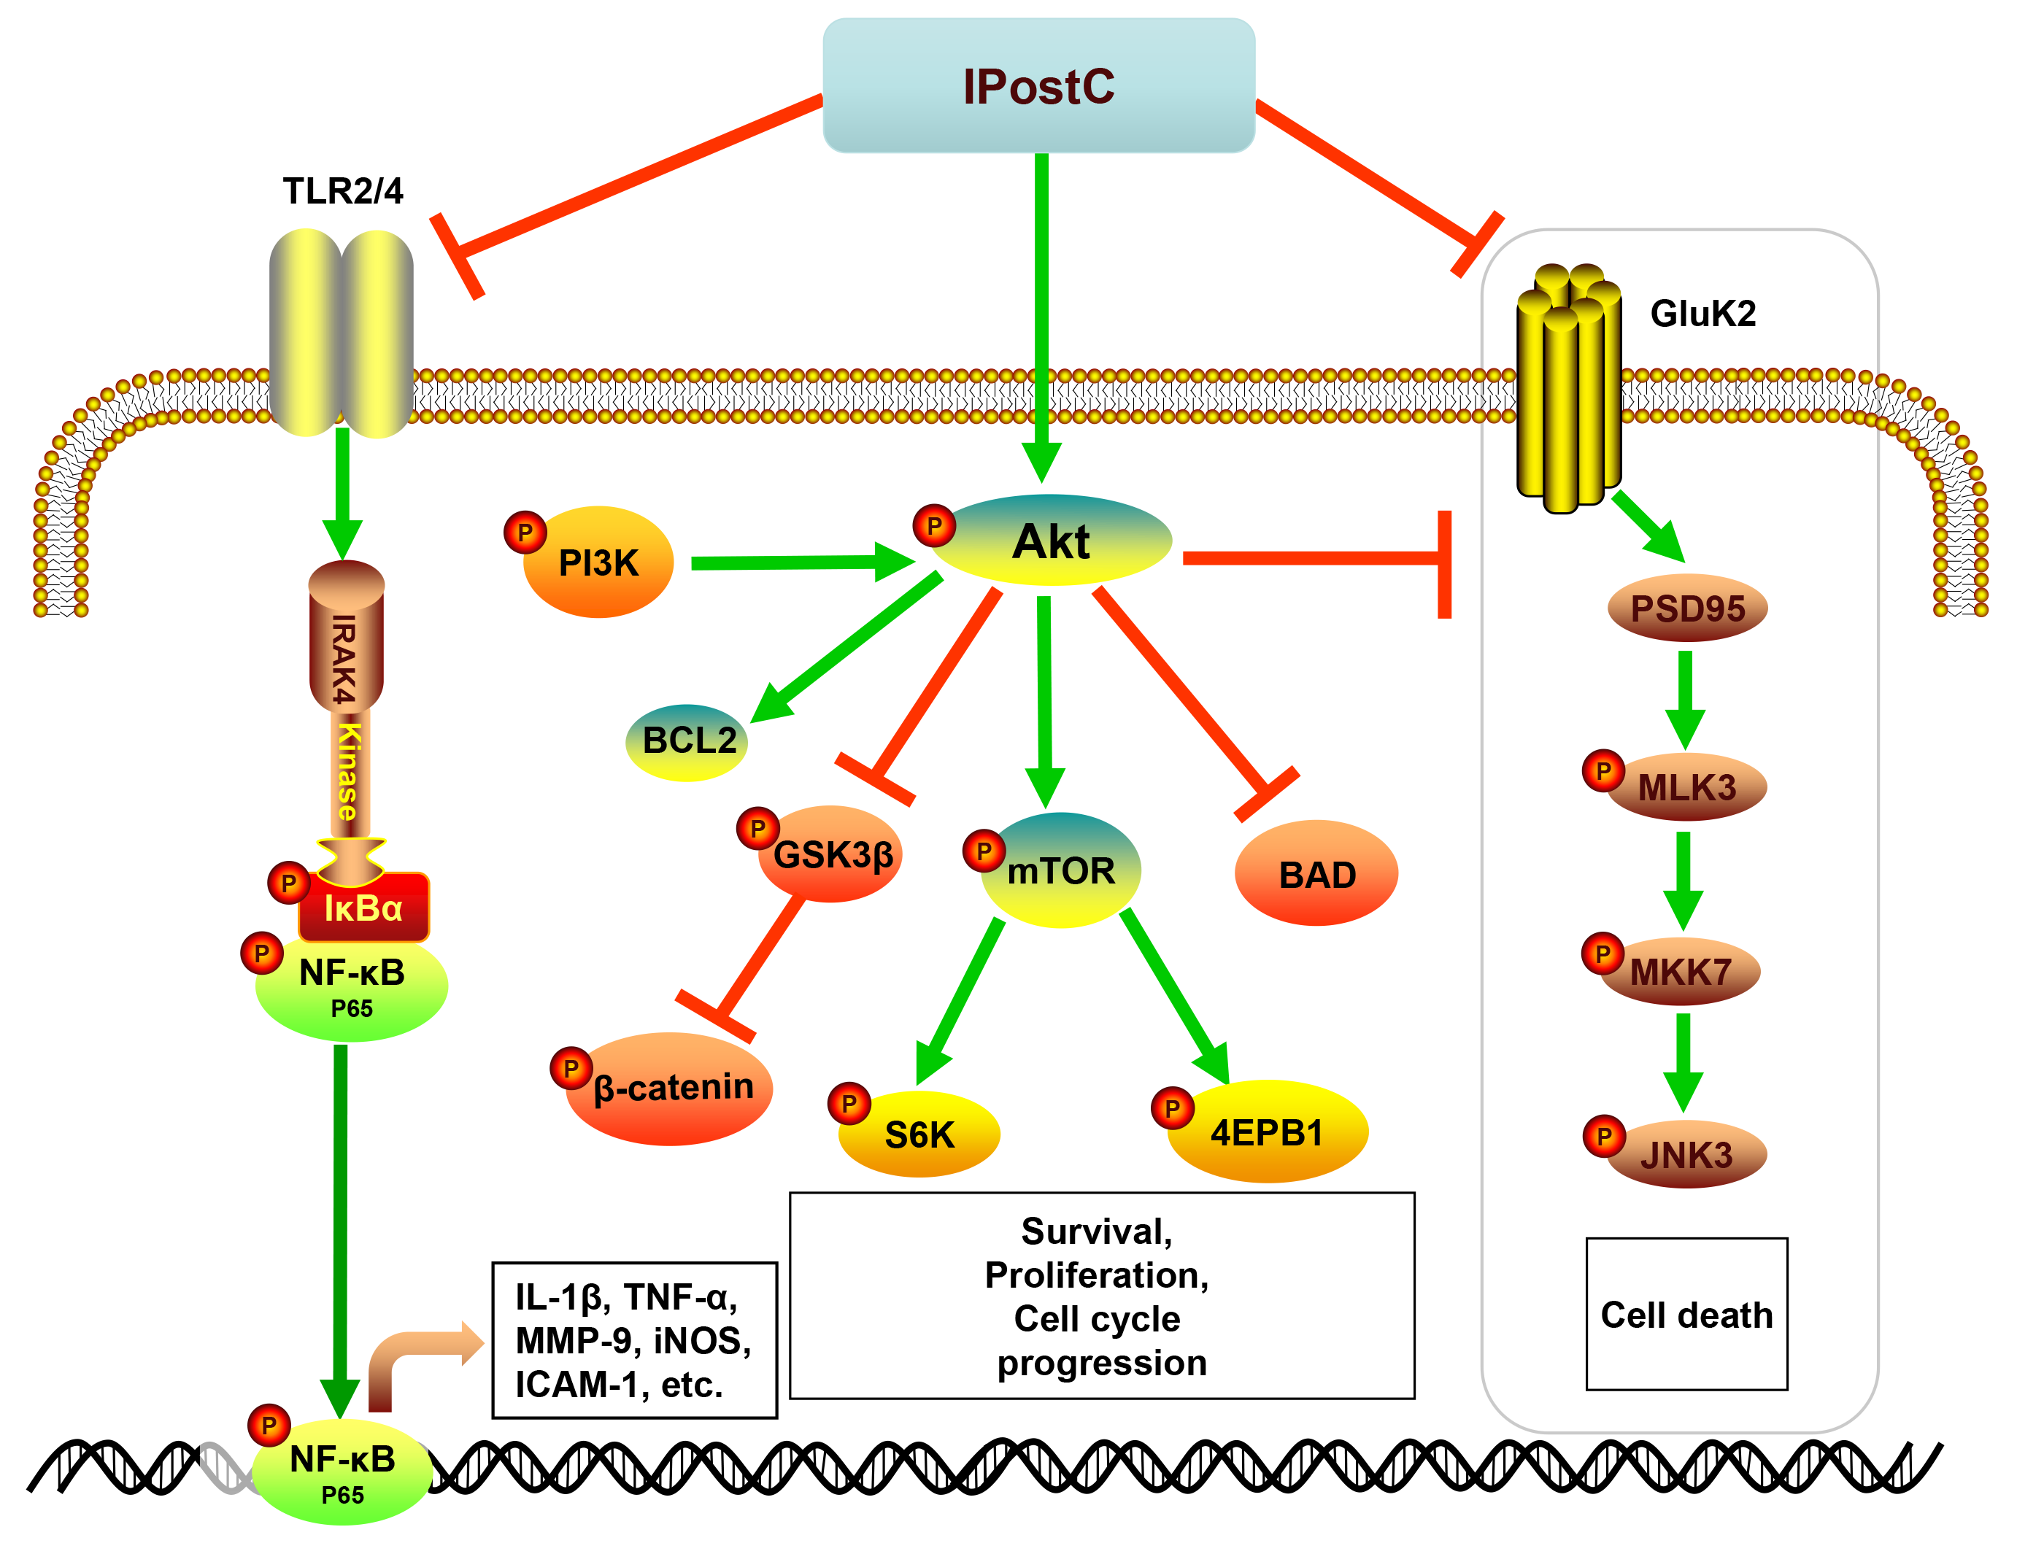
Figure 2. The diagram illustrates the major cellular and molecular signaling pathways activated by IPostC for neuroprotection.
Hansen Chen et al, Conditioning Medicine 2020; 3(2):104-115.

