Slide 1
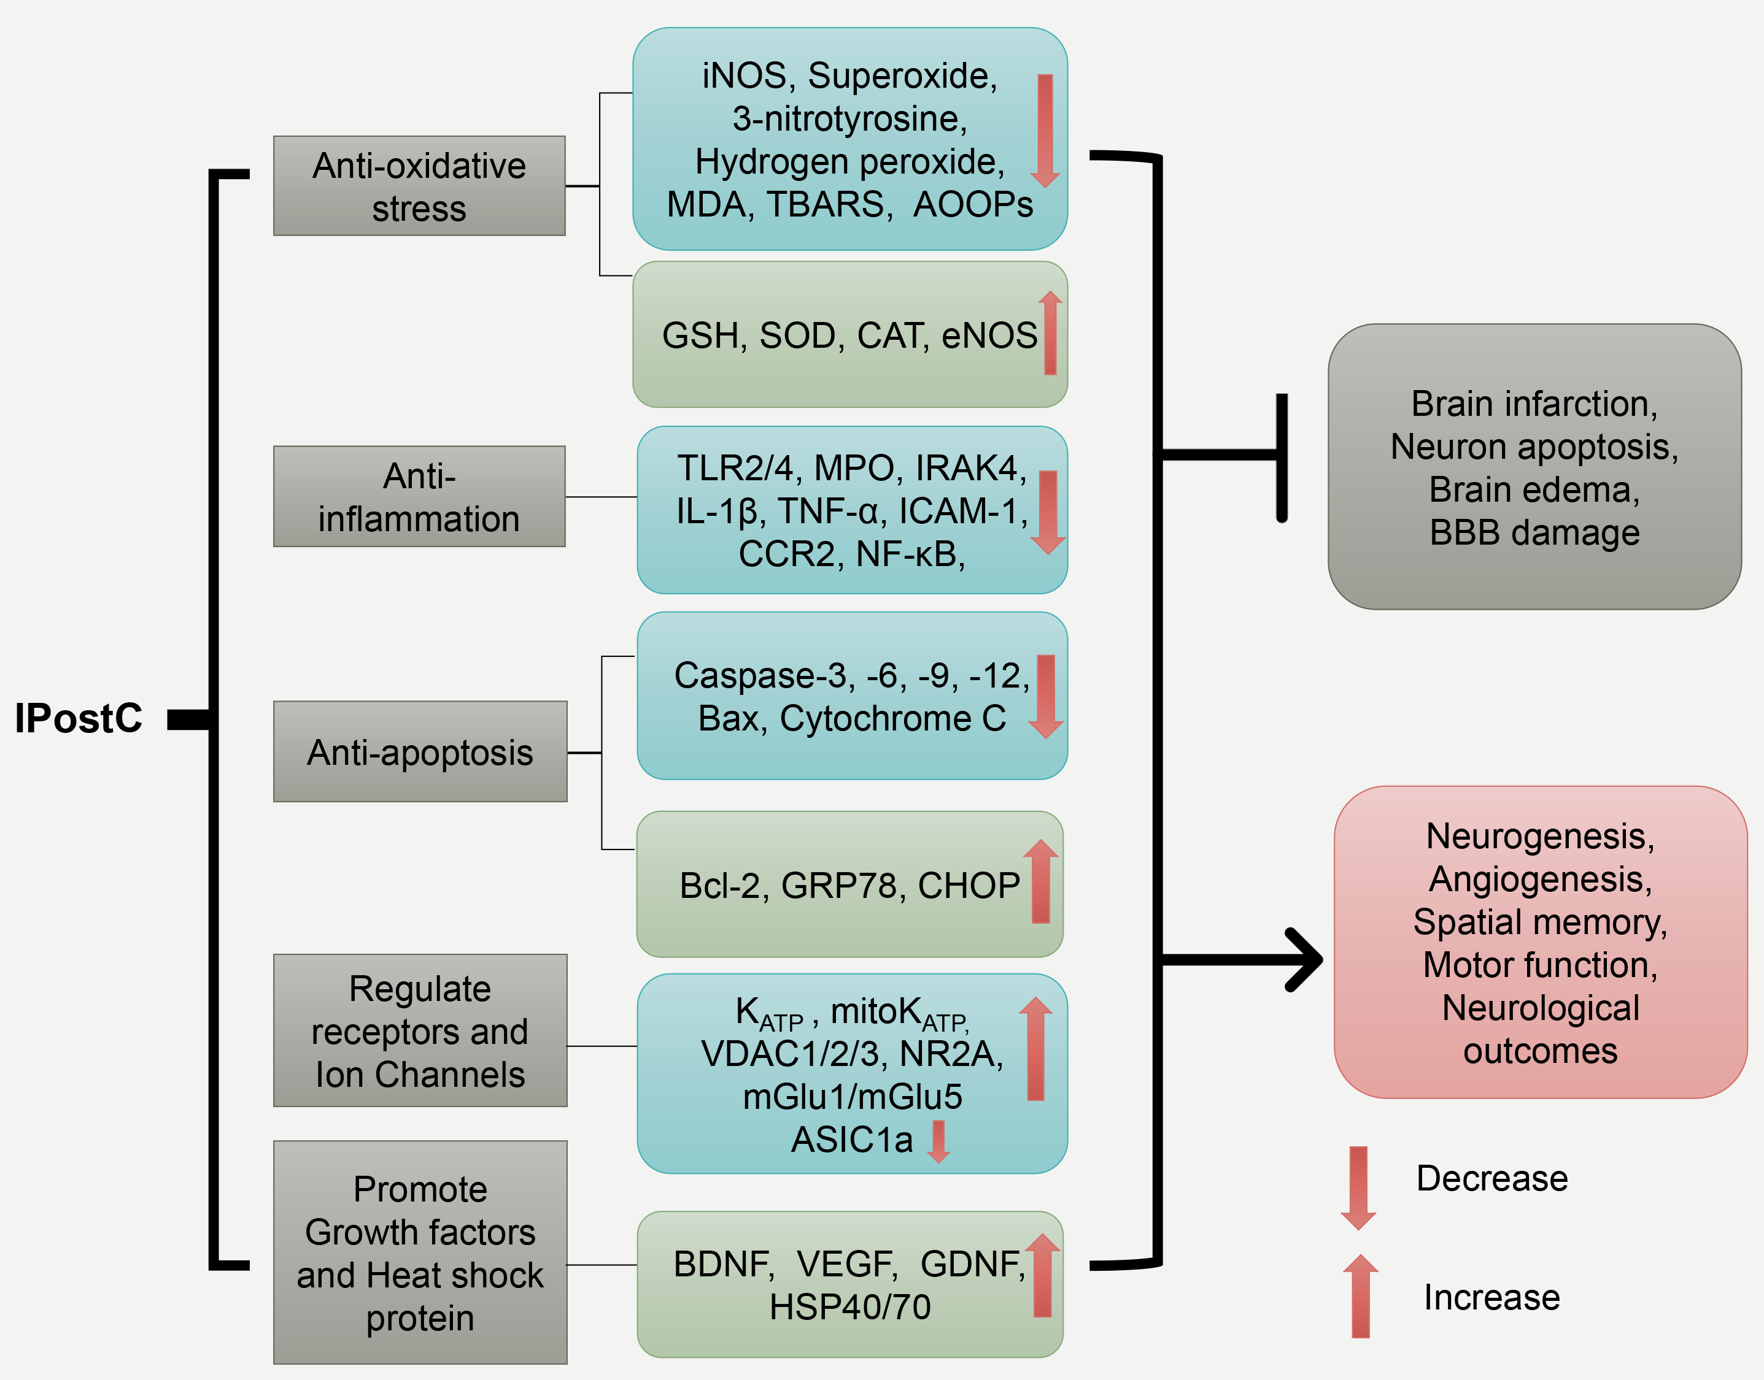
Figure 1. The schematic represents IPostC’s major protective mechanisms.
Hansen Chen et al, Conditioning Medicine 2020; 3(2):104-115.

