Slide 1
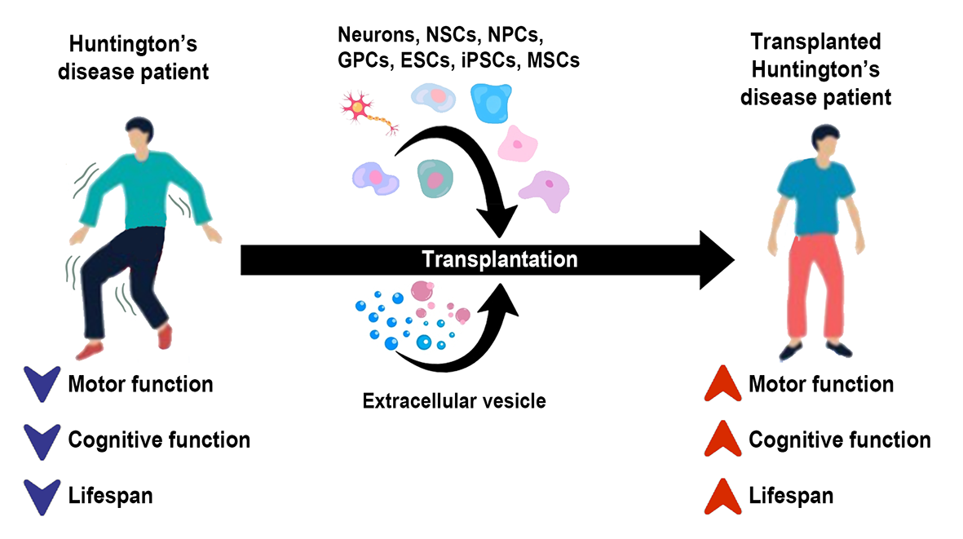
Figure 1.
Putthanbut et al., Conditioning Medicine 2023; 6(6): 177-196.

