Slide 1
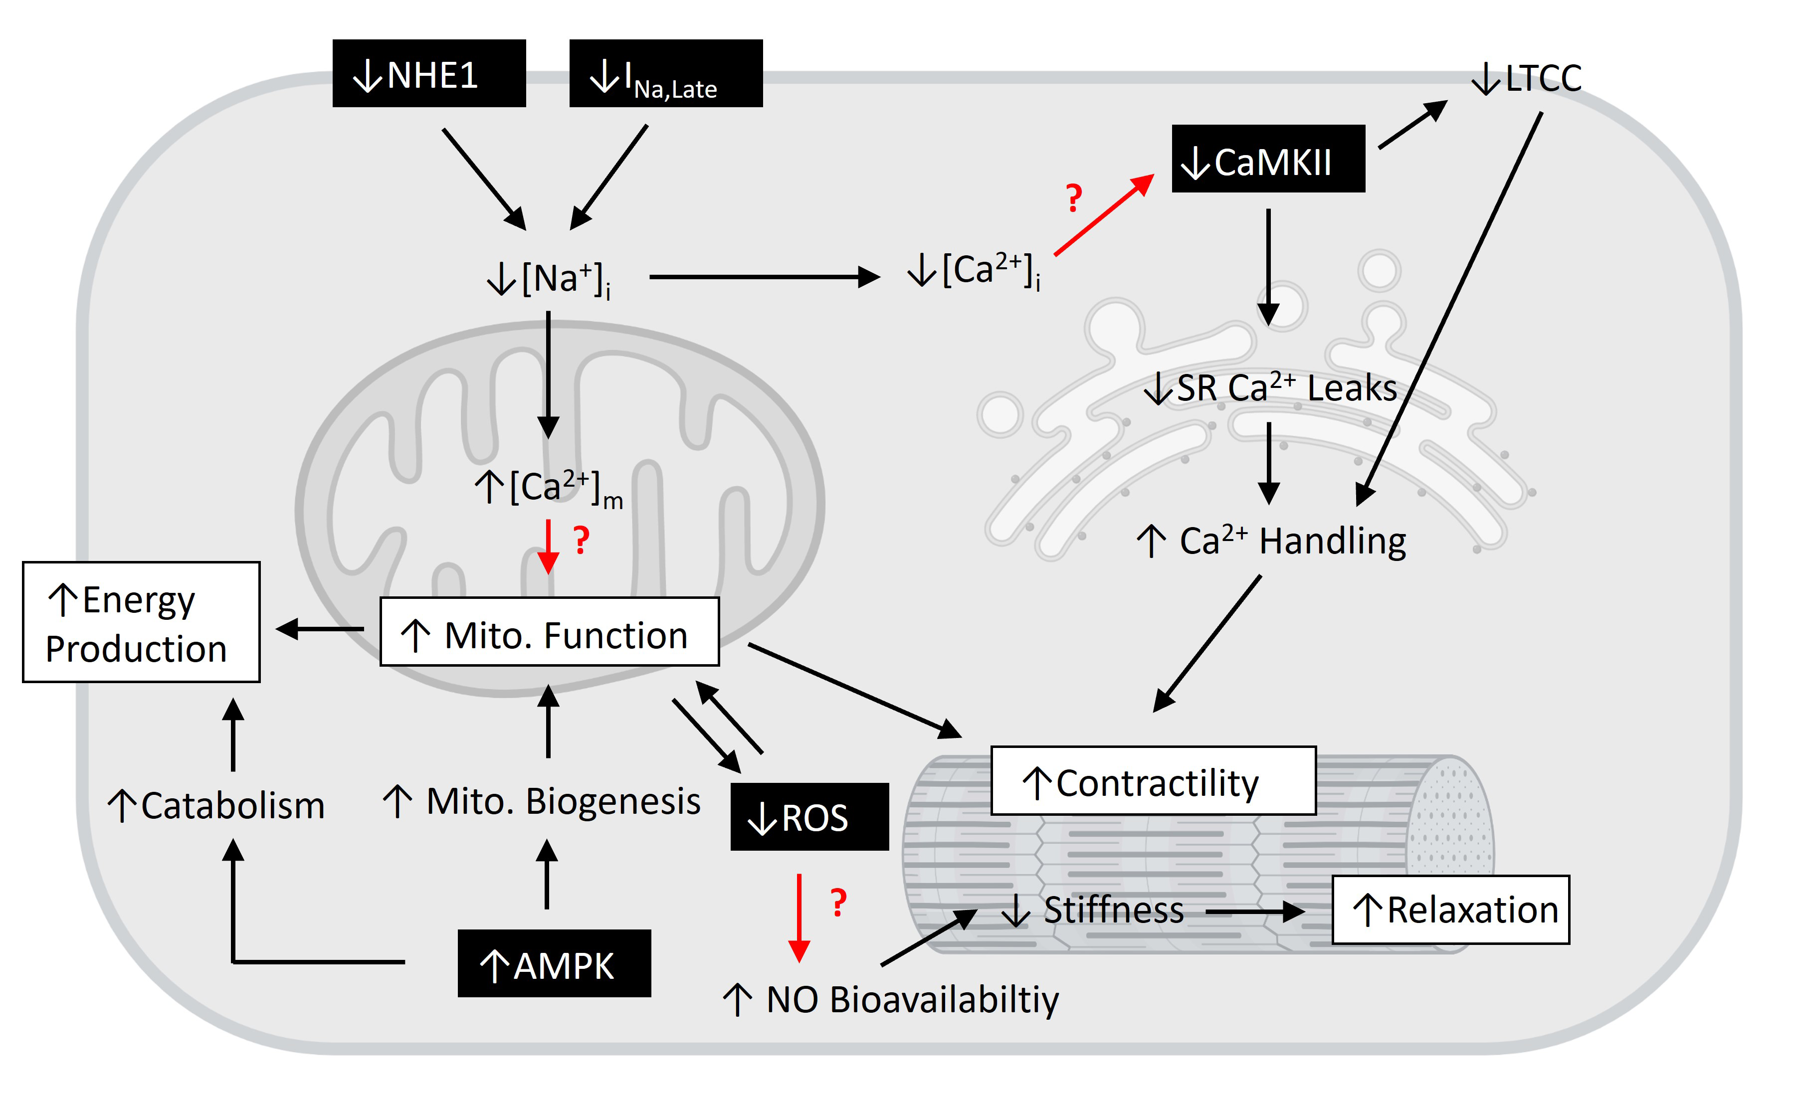
Figure 1.
Lin et al., Conditioning Medicine 2023; 6(2): 42-53.

