Slide 1
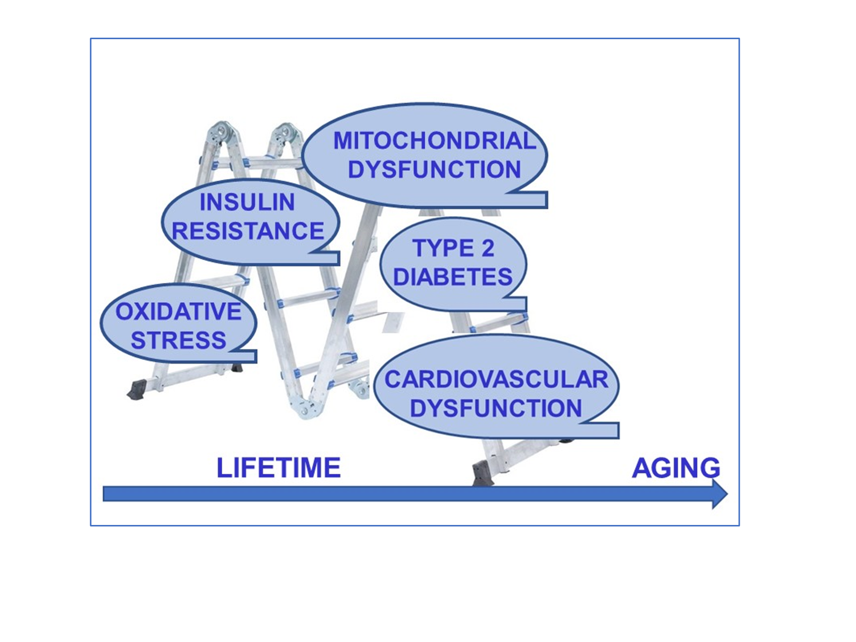
Figure 1.
Billur and Turan, Conditioning Medicine 2022; 5(2):75-84.

