Slide 1
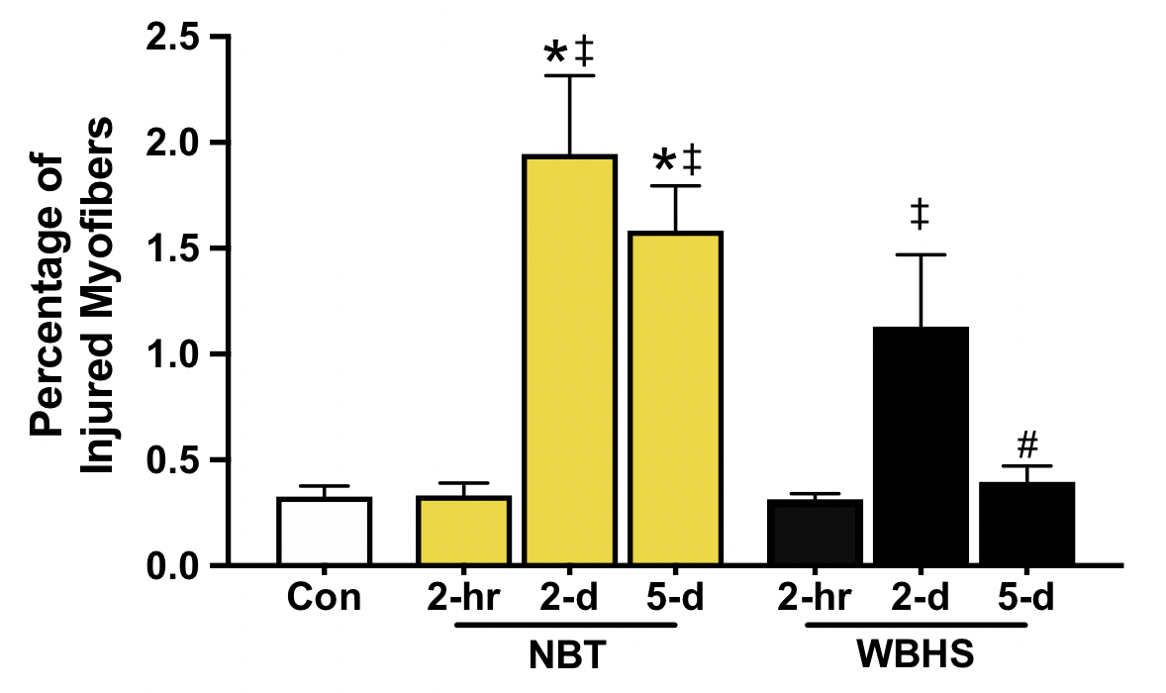
Figure 4. Total number of damaged/regenerating fibers calculated as a percentage of the total number of fibers that demonstrated overt signs of injury.
Godwin et al., Conditioning Medicine 2020; 3(4):184-191.

