Slide 1
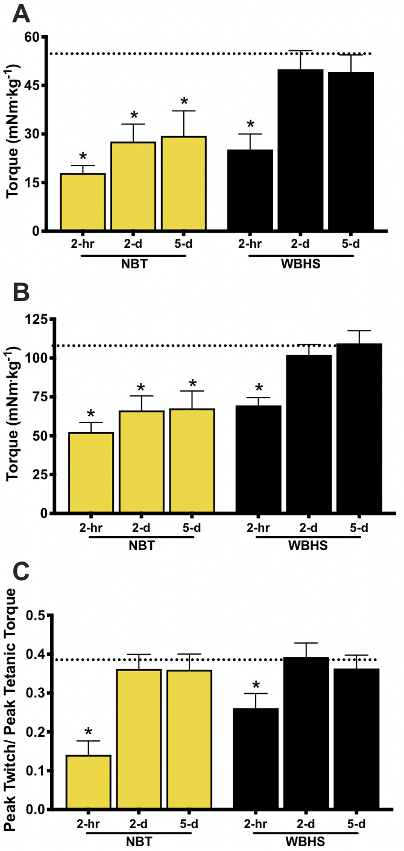
Figure 2. Submaximal and maximal in vivo torque and peak twitch/ peak tetanic torque ratios.
Godwin et al., Conditioning Medicine 2020; 3(4):184-191.

