Slide 1
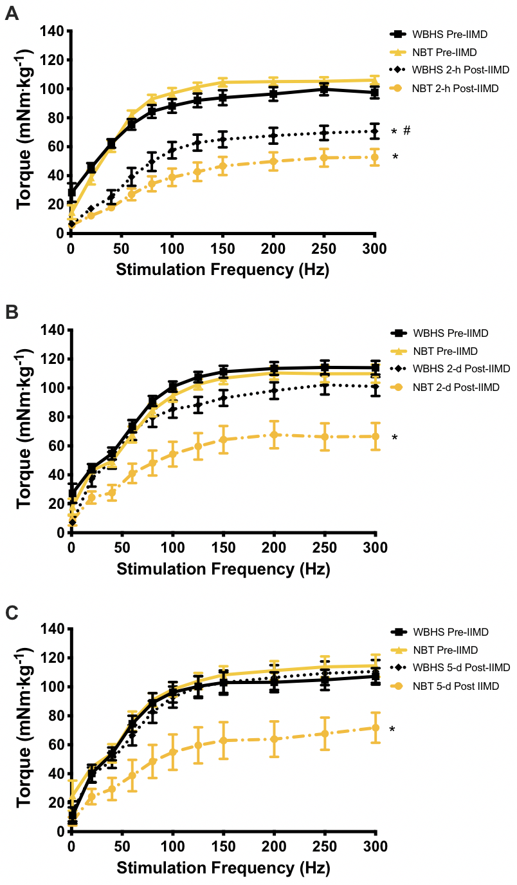
Figure 1. In vivo torque-frequency relationship pre-impact induced muscle damage (IIMD) and post-IIMD.
Godwin et al., Conditioning Medicine 2020; 3(4):184-191.

