Slide 1
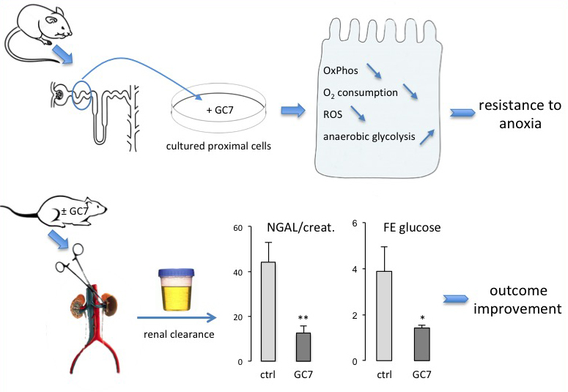
Figure 2. Schema of the translation of the concept that arose from a model organism to an integrative mammalian model of ischemia.
Michel Tauc et al., Conditioning Medicine 2019; 2(2):69-74.

