Slide 1
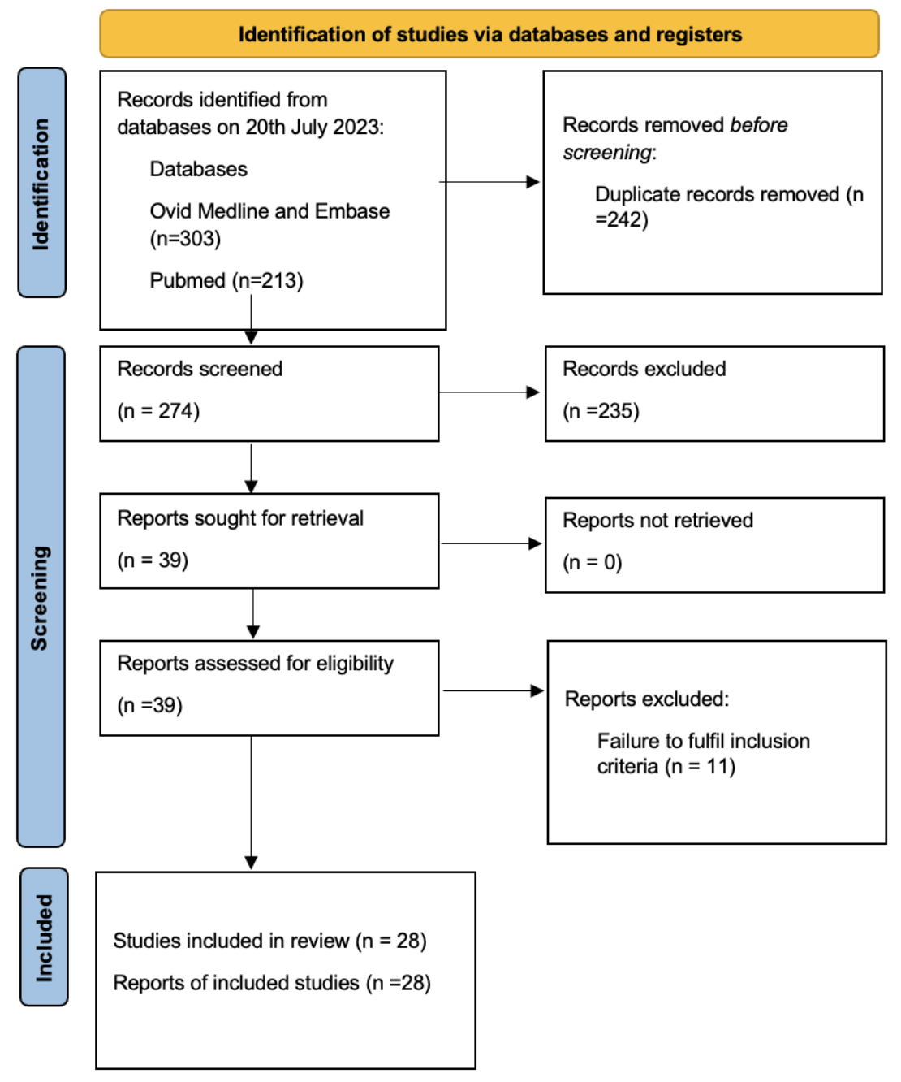
Figure 1.
Rastogi et al., Conditioning Medicine 2023; 6(2): 25-32.

