Slide 1
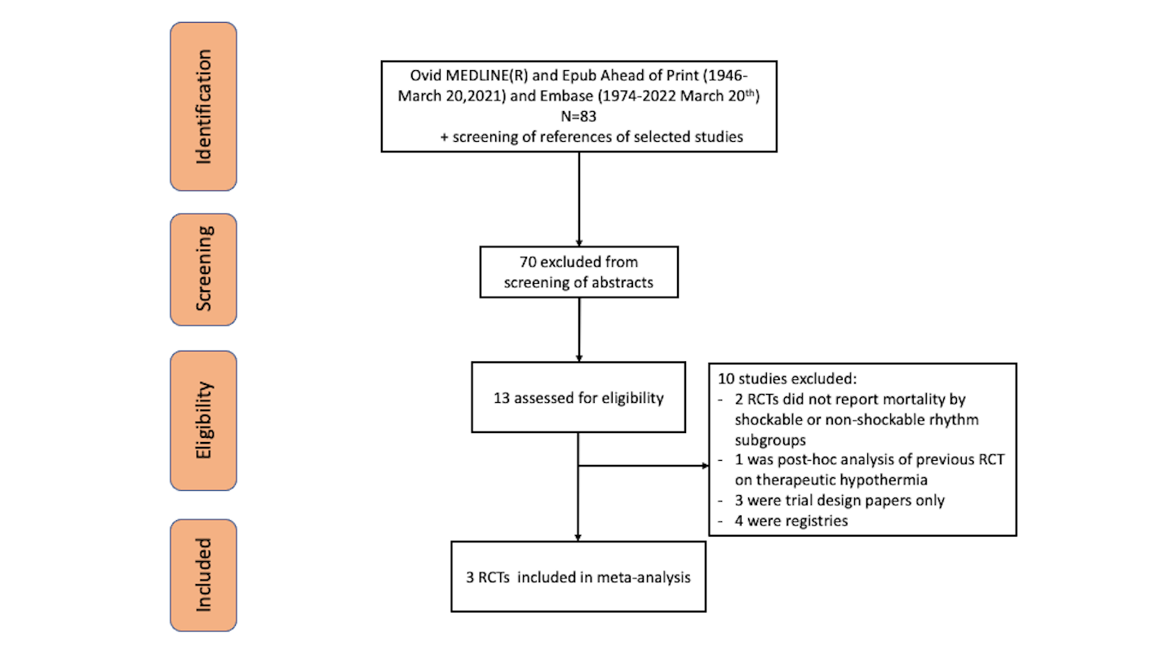
Figure 1.
Lane et al., Conditioning Medicine 2022; 5(2):70-74.

