Slide 1
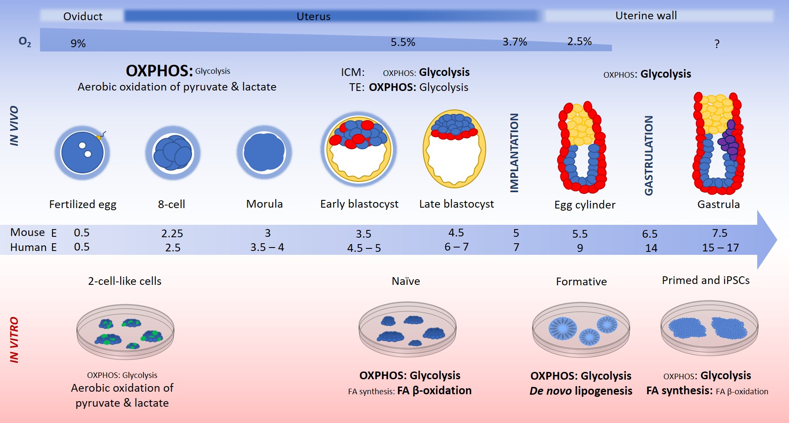
Figure 1. Fertilization of the mammalian egg occurs at embryonic day (E) 0.5 in the oviduct, which resides at ~9% oxygen.
Lees et al., Conditioning Medicine 2021; 4(2):88-99.

