Slide 1
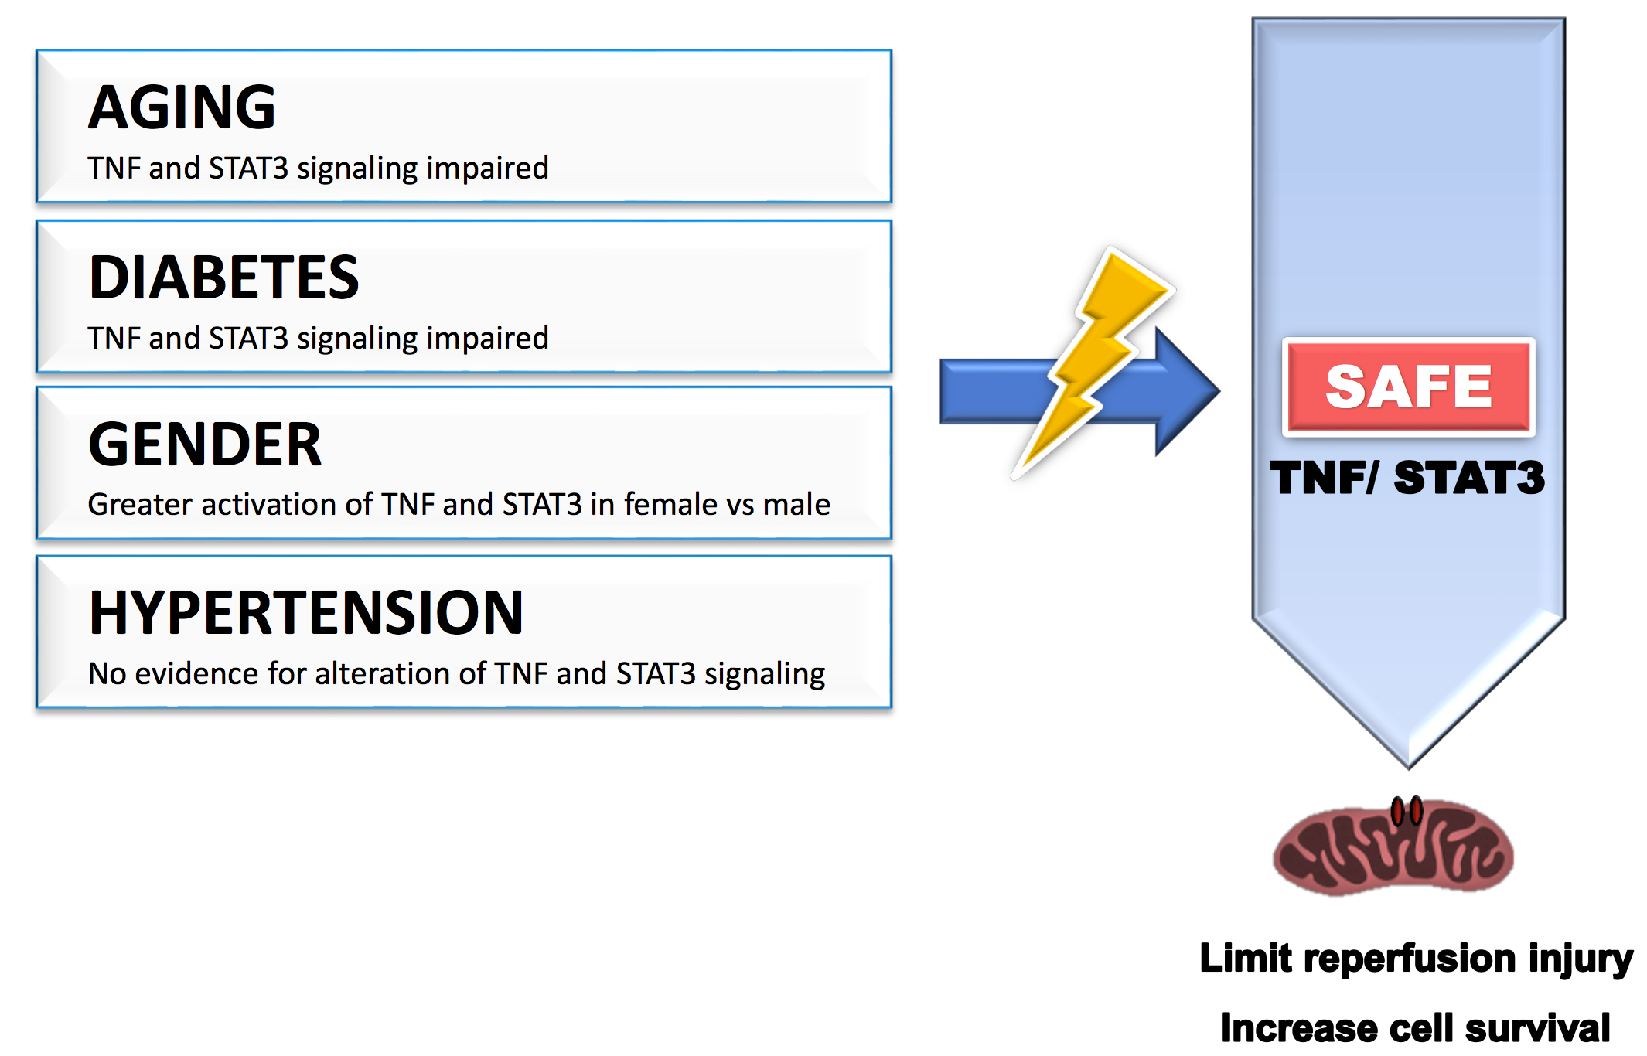
Figure 1. Cardiovascular risk factors such as age, gender, diabetes, and hypertension may affect the benefit of cardioprotective strategies by modulating the activation of the SAFE pathway.
Aqeela Imamdin et al, Conditioning Medicine 2020; 3(2):98-103.

